Slide 1
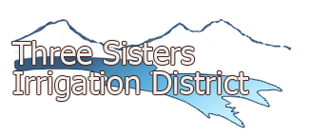
Cooperation & Collaboration
How a Little Central Oregon Irrigation District
Got to See a Miracle Happen
Marc Thalacker
Three Sisters Irrigation District

Slide 2
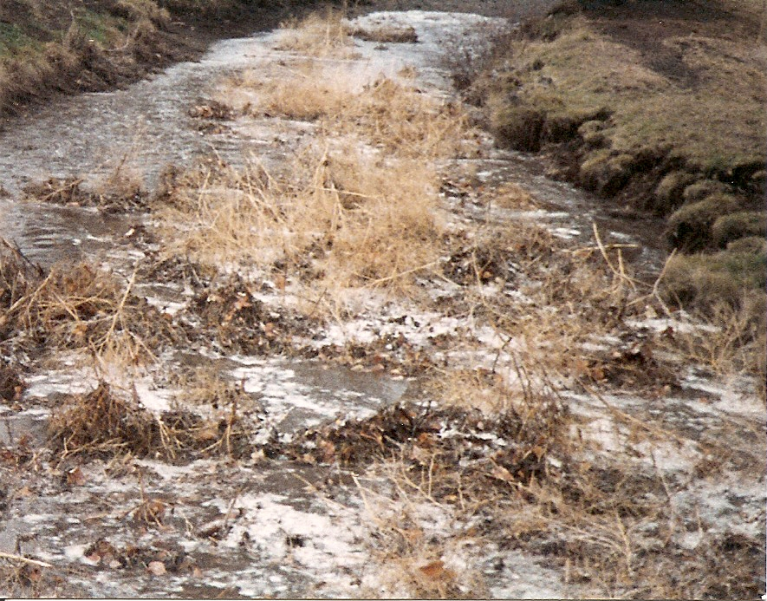
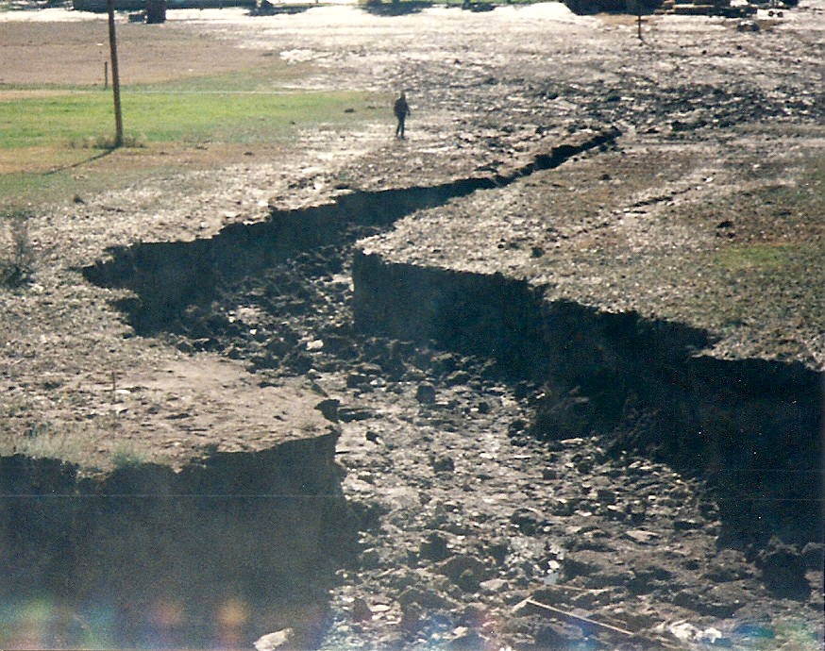
Open Ditch Liabilities
Ditch Loss
Pollution
Flood Damage
Safety
Maintenance Nightmares
Operating Inefficiency

Slide 3
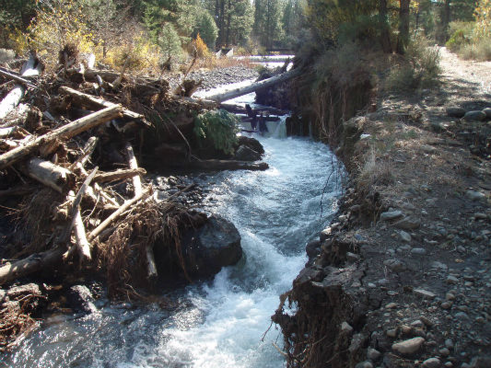
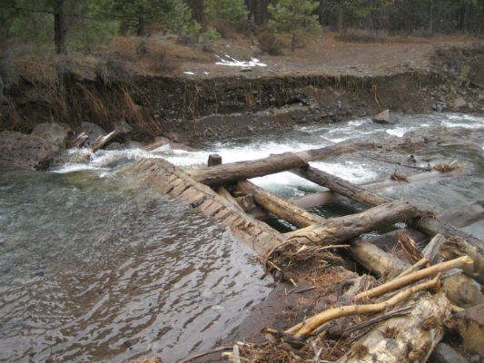
Old Aging Infrastructure

Slide 4
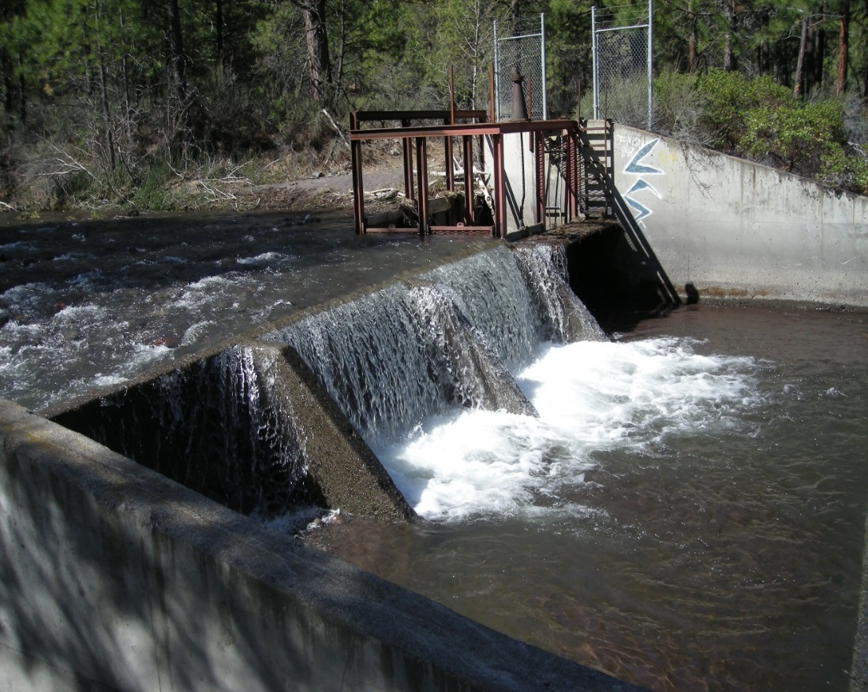
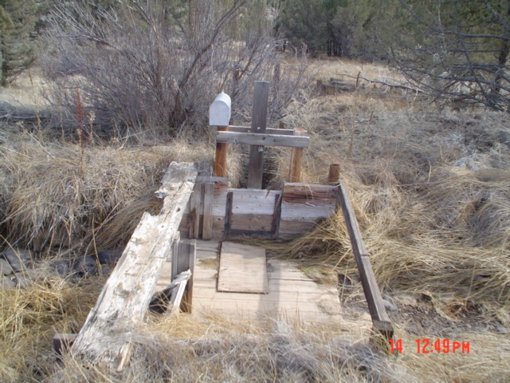
Newer Aging Infrastructure

Slide 5

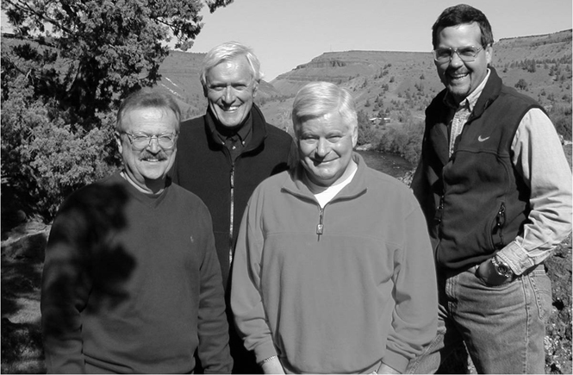
Building
Relationships
You have to find collaborative partners
  Conservancies
  Watershed Councils
  Soil and Water Conservation Districts
Consensus is Difficult

Slide 6







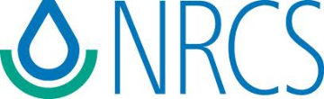
Cooperative Partnership Goals
Water Conservation
Energy Conservation
Carbon Footprint Reduction
Sustainable Agriculture
Anadromous Re-introduction
Stream Restoration
Made Possible by Statute

Slide 7
Making a difference
1998 first started piping
2001 Cloverdale Project
2005 McKenzie Canyon Project
2009 Whychus Creek Diversion and Fish Screen
2010 Watson to McKenzie Main Canal Pipeline
2014 Watson Hydroelectic Facility
2018 Watson Net Metering Micro-Hydro Demonstration Project
2018 McKenzie Reservoir Hydroelectric Facility
2018 Completion of the piping of all 31.5 miles of District canals
2020 Completion of the piping of all 28 miles of private lateral canals
2021 TSID has a Carbon Neutral Footprint

Slide 8
Eat the Elephant
One Bite at a Time
Screening and Passage
Penstock in Phases
Hydro

Slide 9
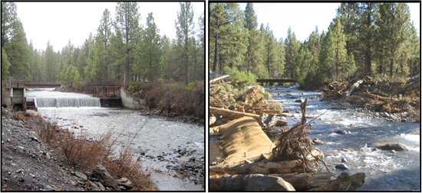
Stream Restoration

Slide 10
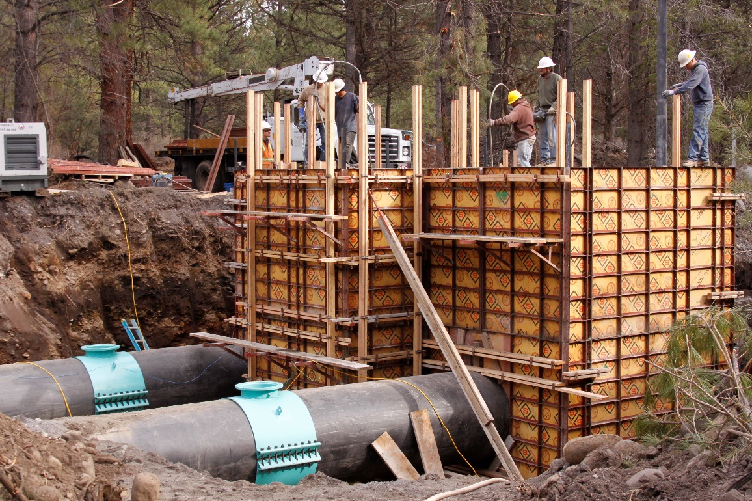
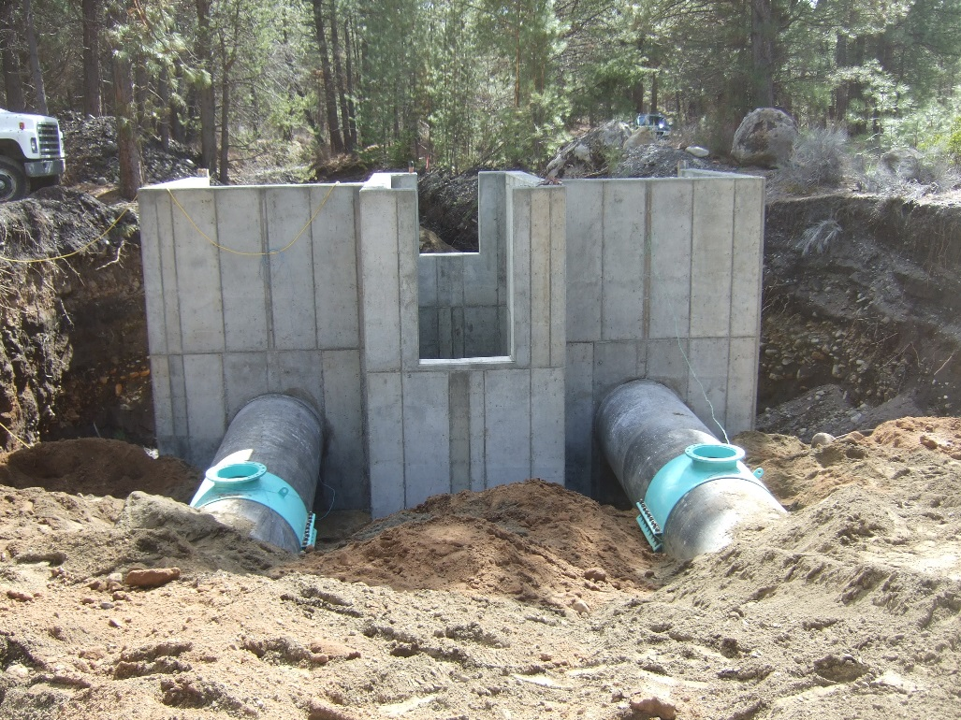
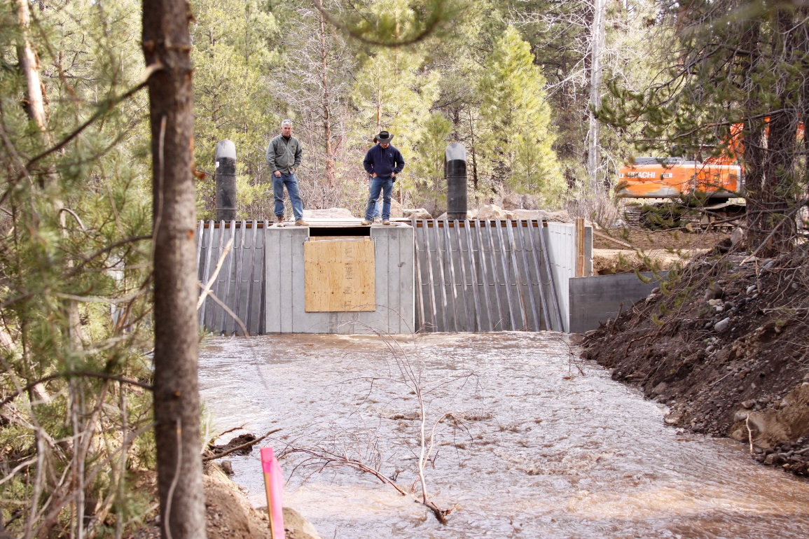
Headwall for Fish Screen

Slide 11
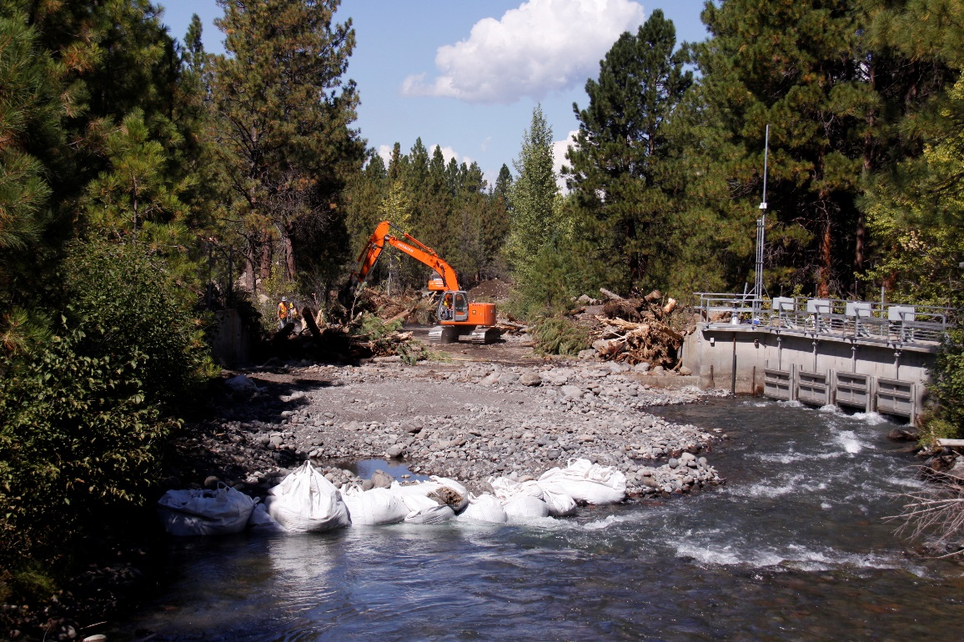
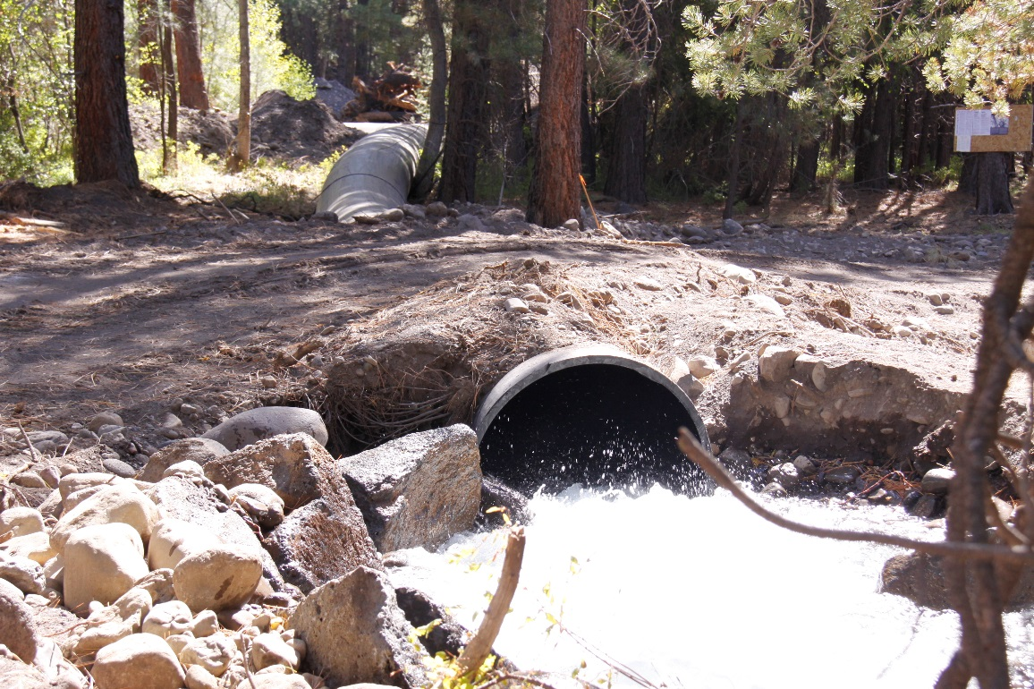
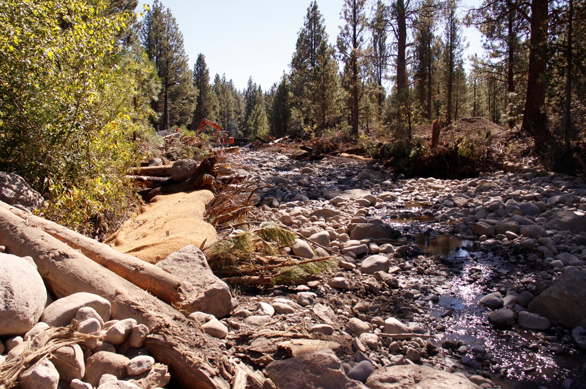
Restoration Construction

Slide 12
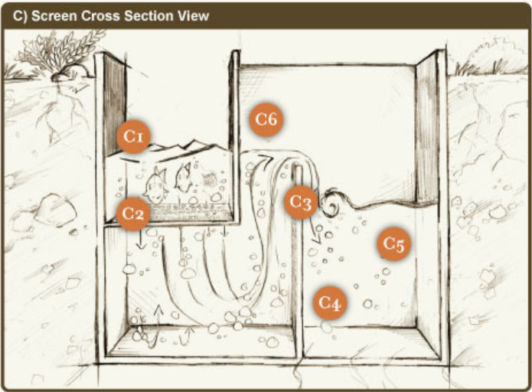
How it Works
farmerscreen.org

Slide 13
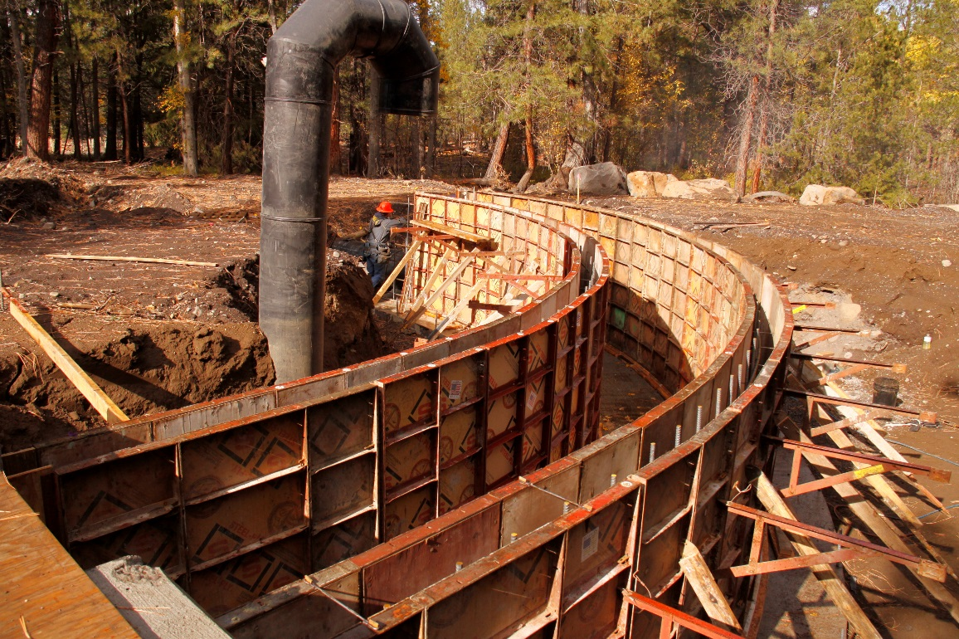
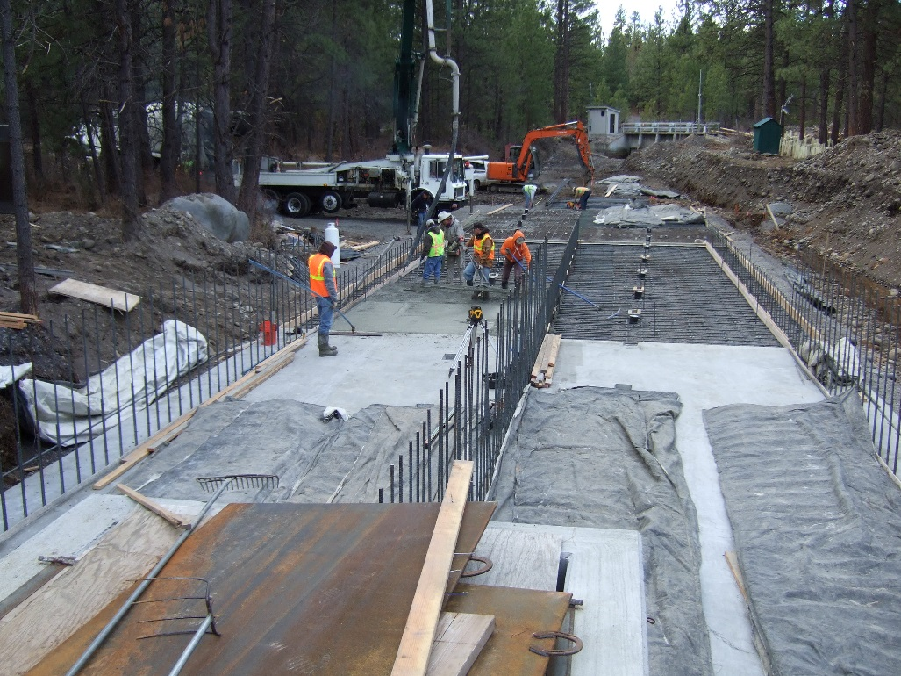
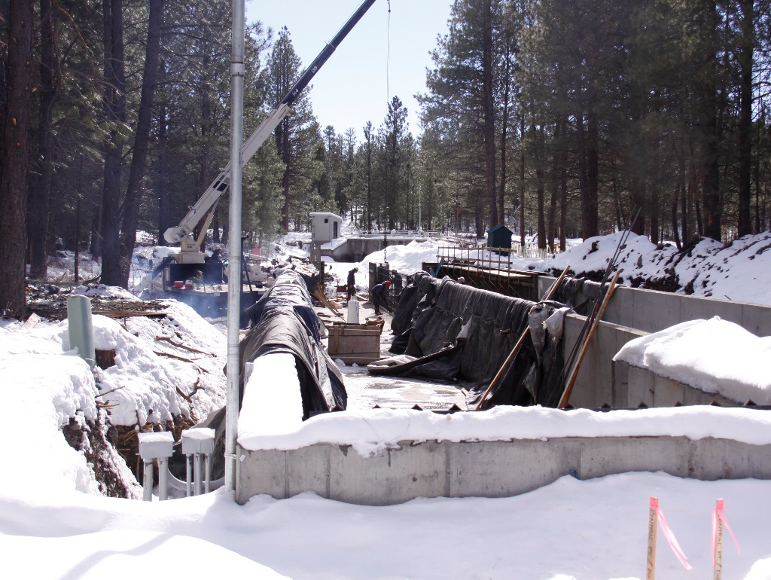
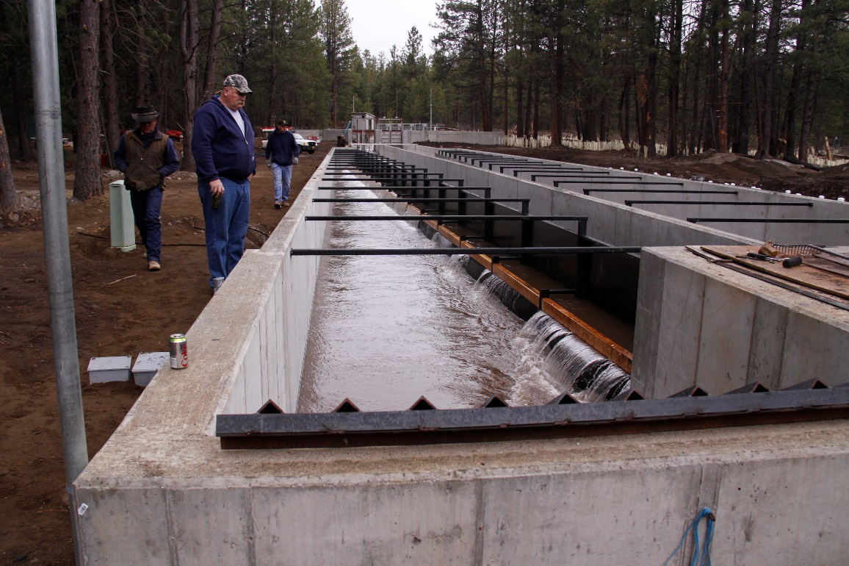

Slide 14
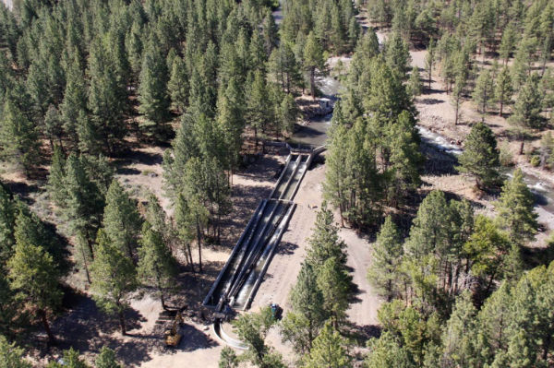
Completed Fish Screen

Slide 15
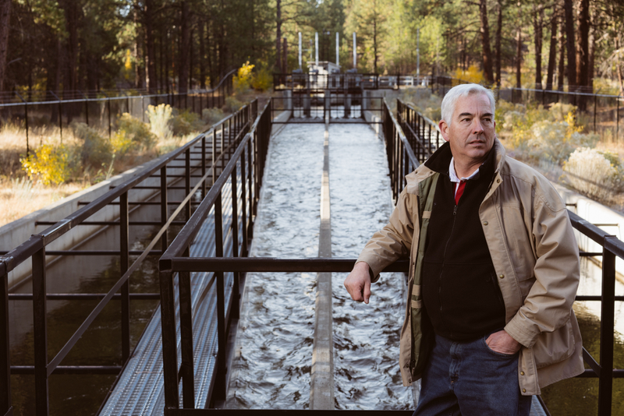
No Moving Parts or Power

Slide 16
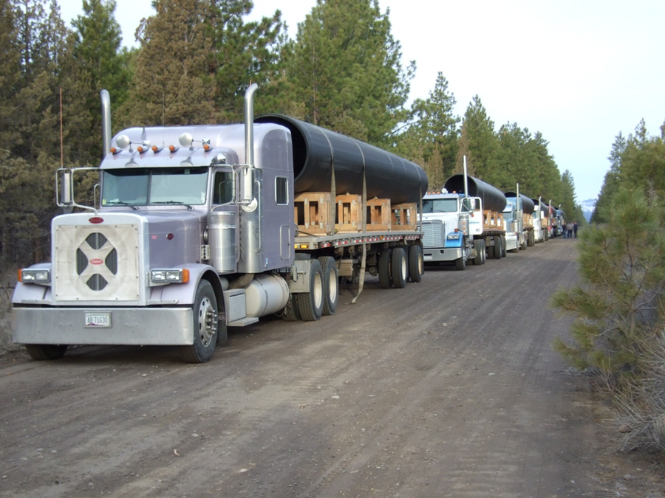
Trucks Arrive with HDPE

Slide 17
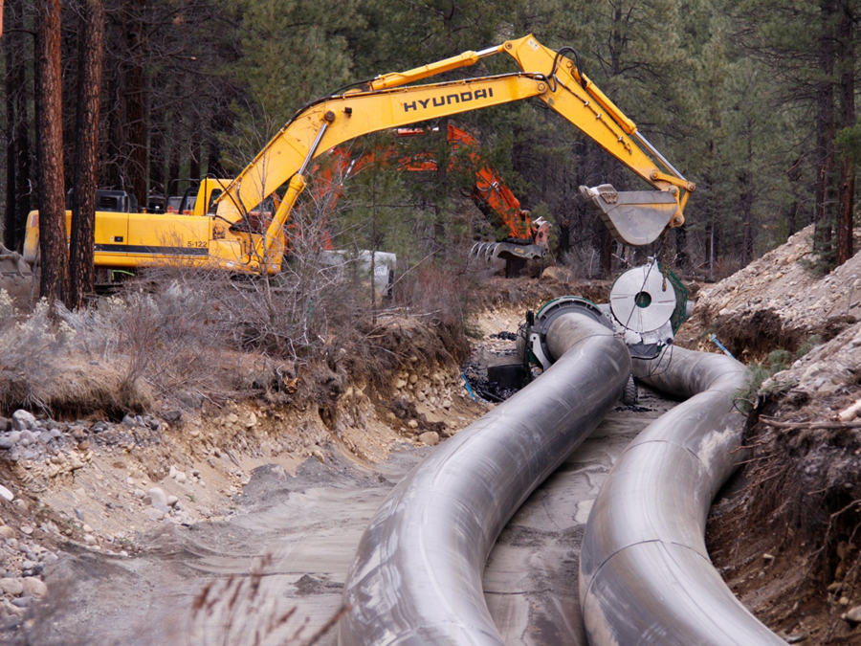
Double S Turn

Slide 18
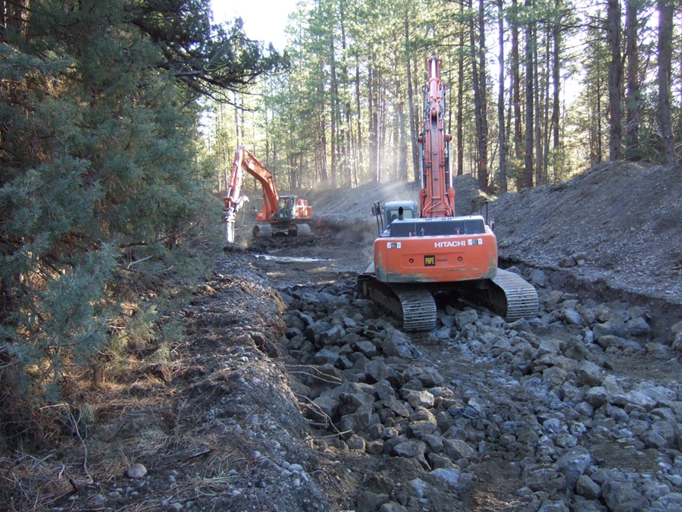
Obstacles

Slide 19
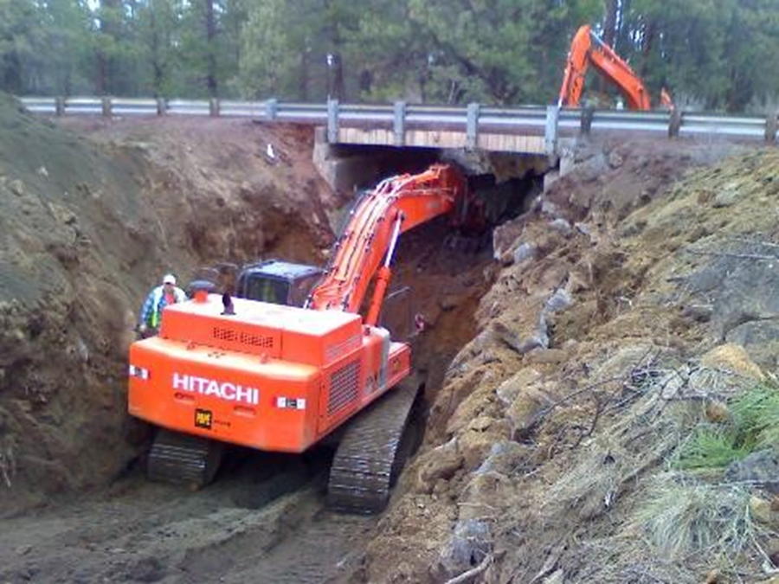
Highway 20 Bridge

Slide 20
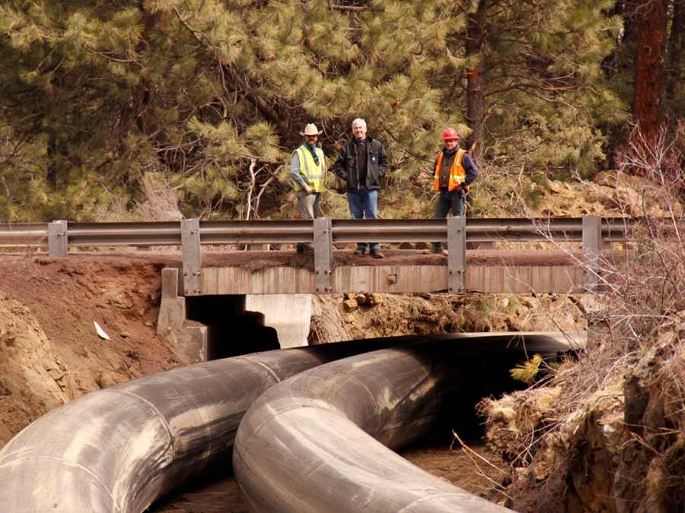
ODOT Retires Bridge Over Canal

Slide 21
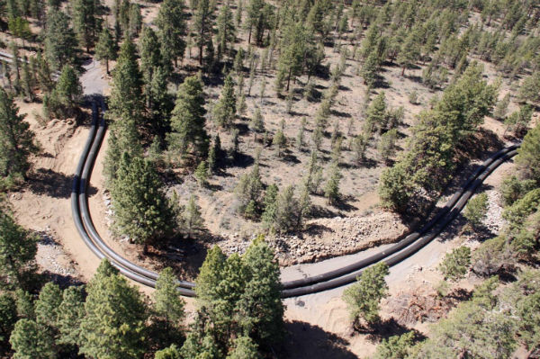
Penstock
Notes:
Done in 3 phases.

Slide 22
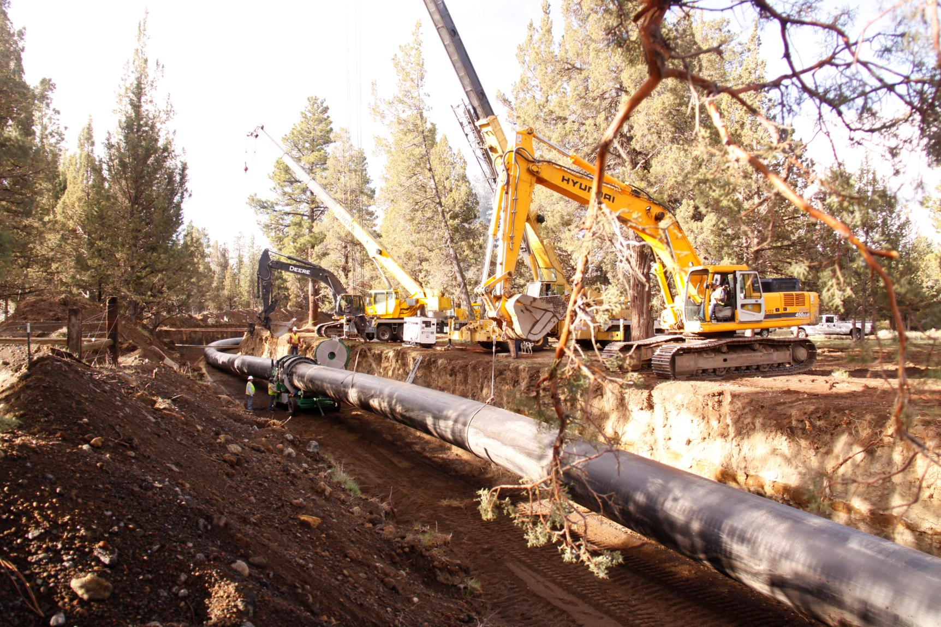
Keeco Cranes

Slide 23
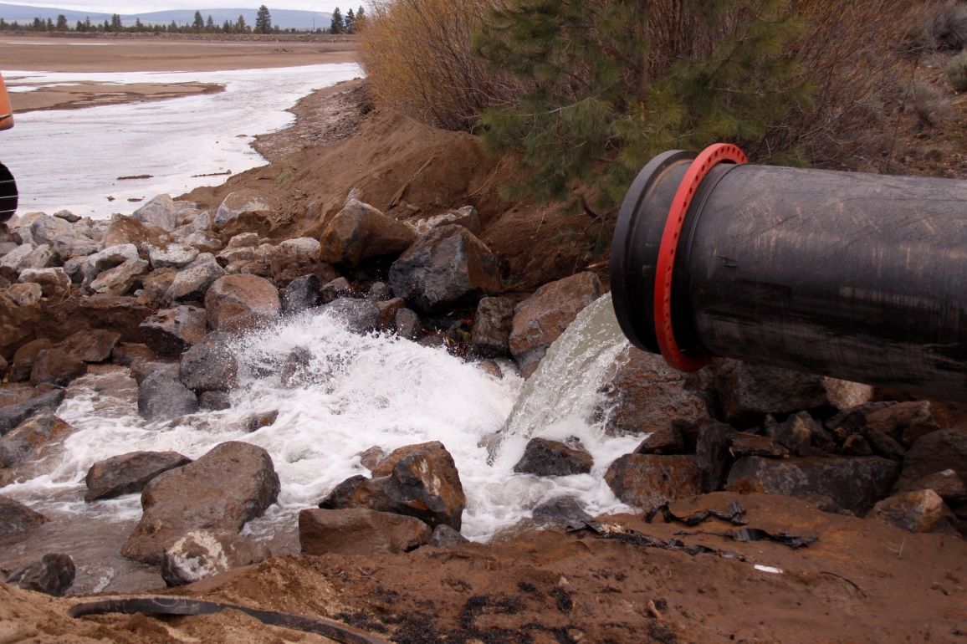
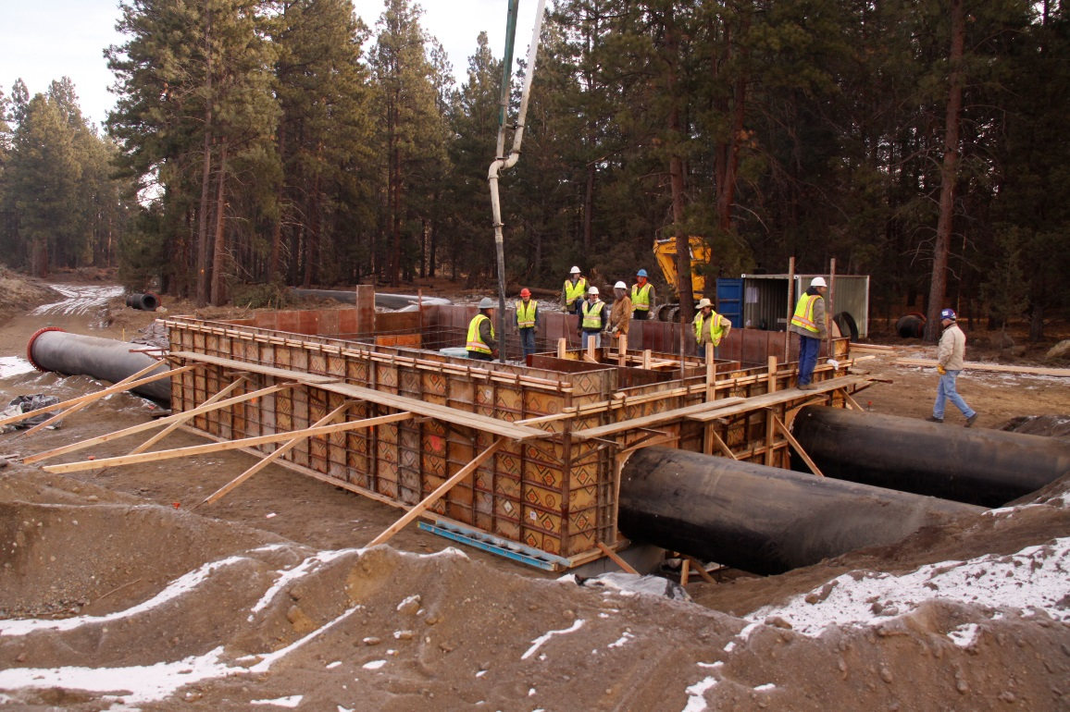
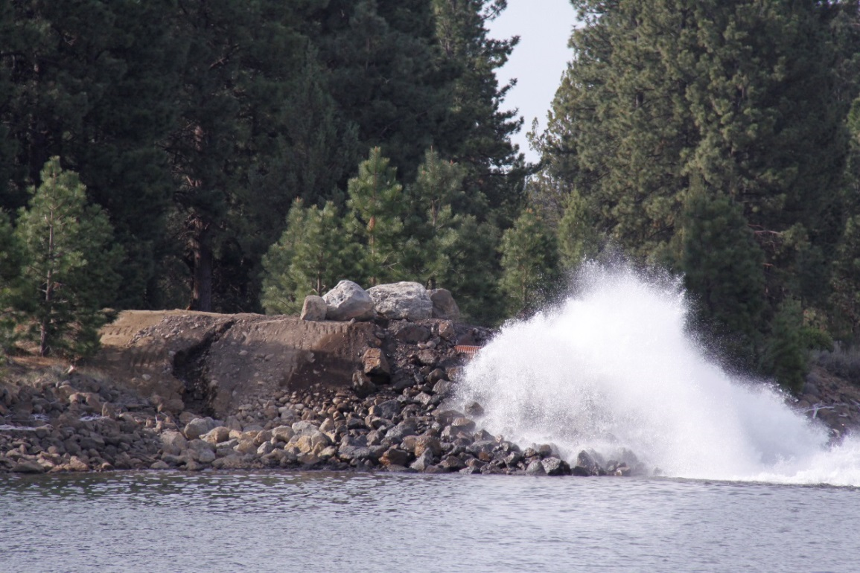
Penstock at Powerhouse Site

Slide 24
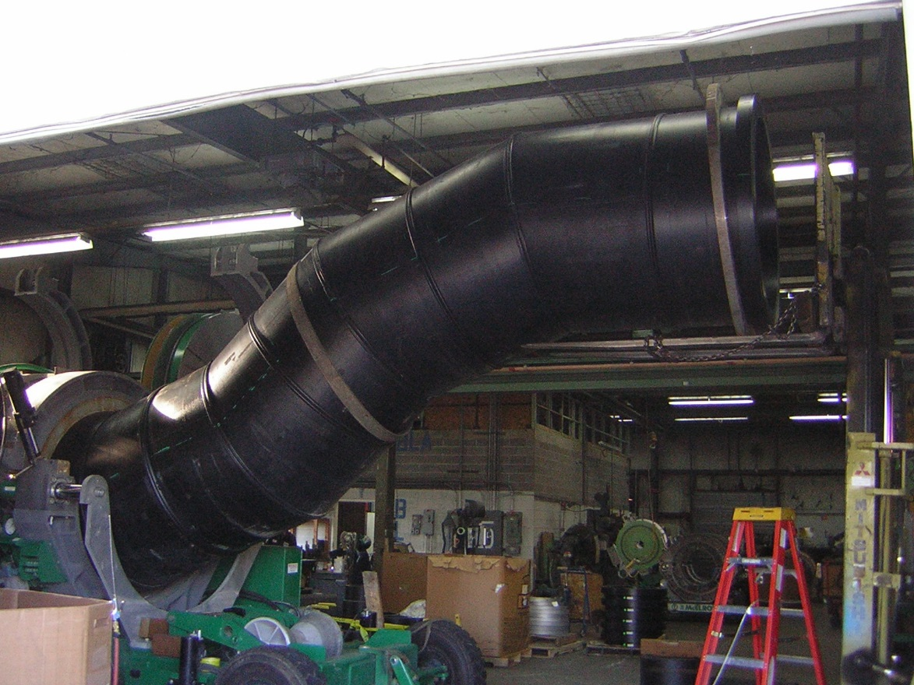
Z-Pipe

Slide 25
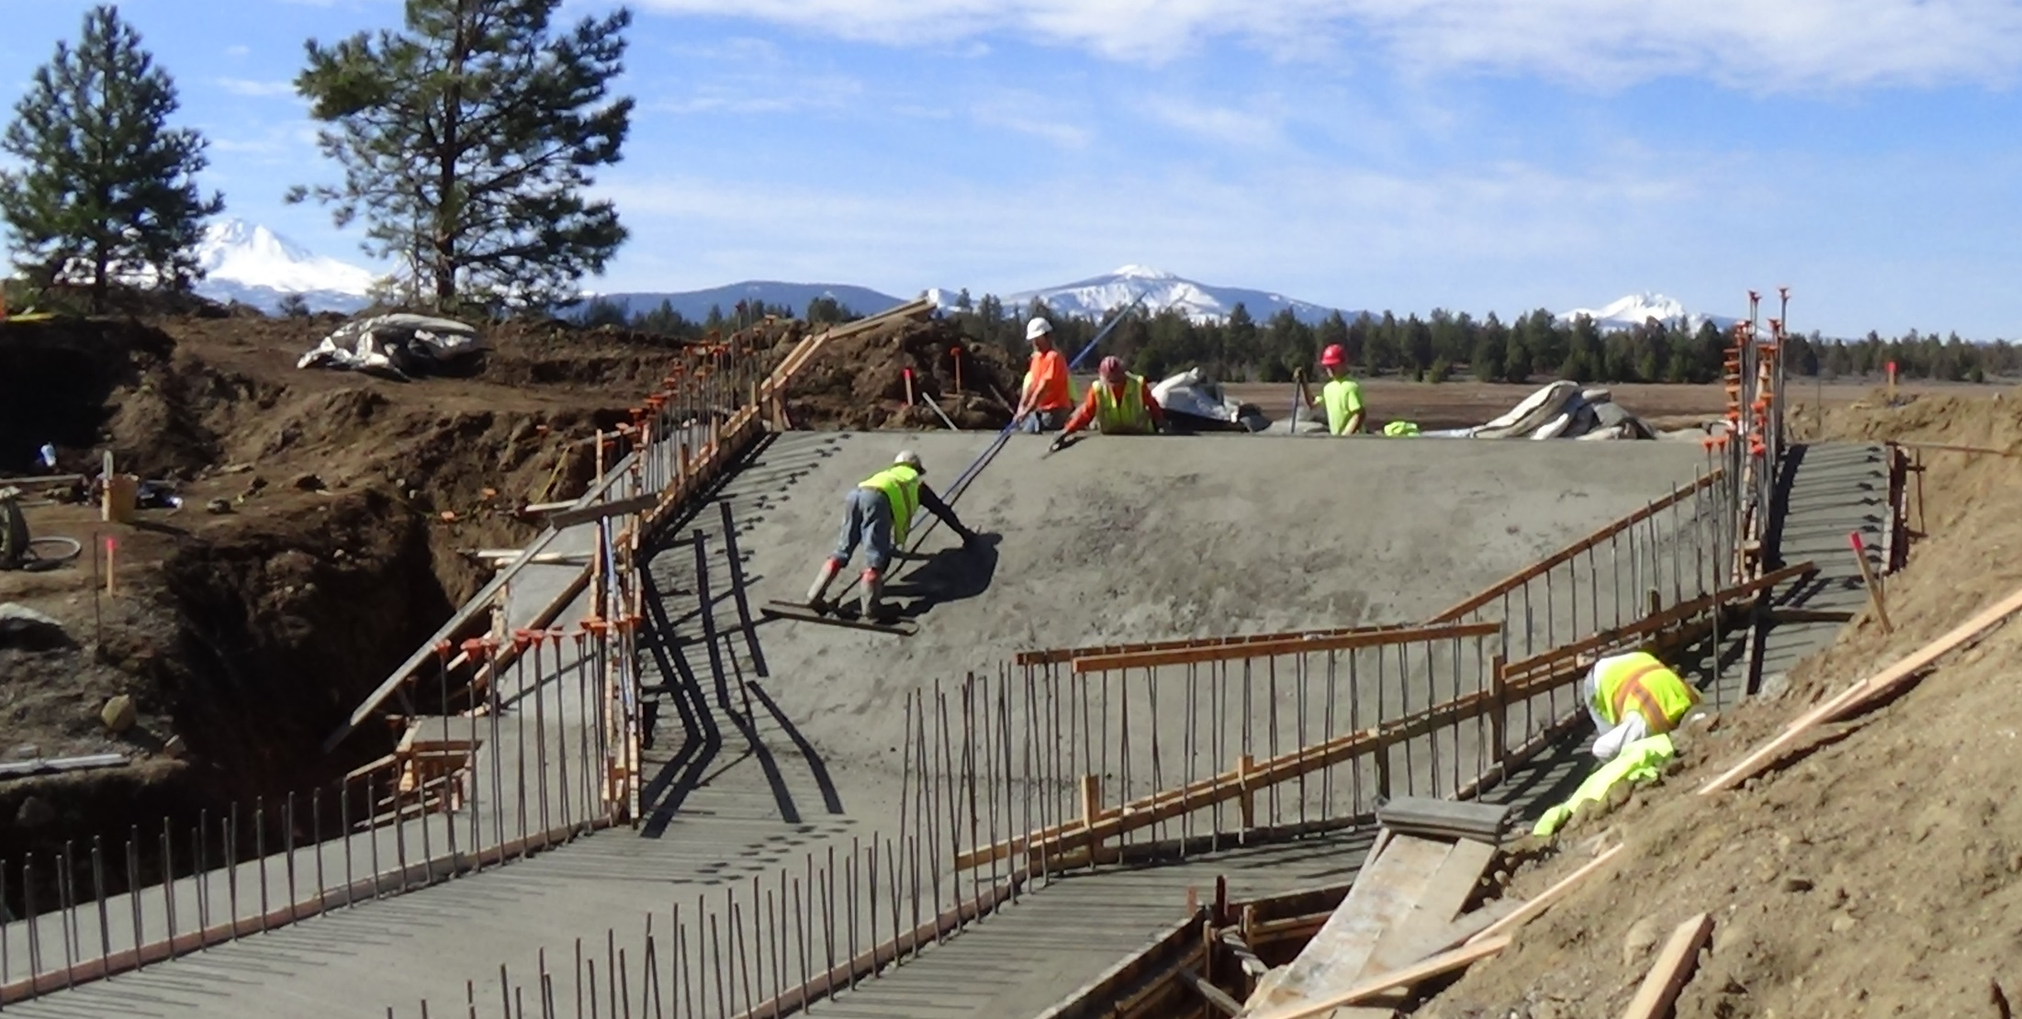
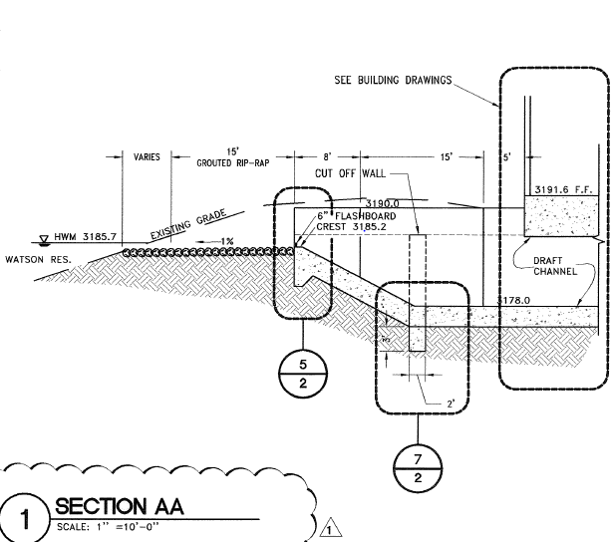
Tailrace

Slide 26
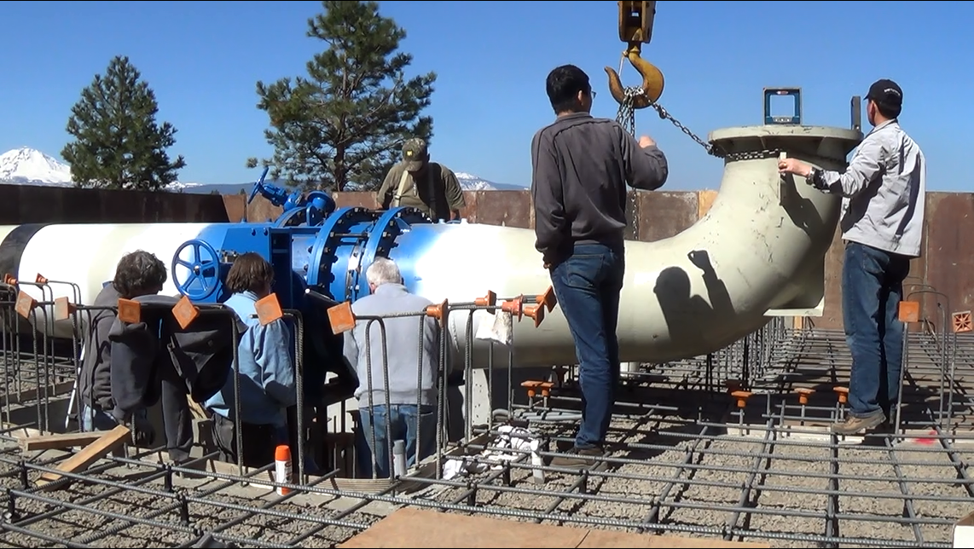
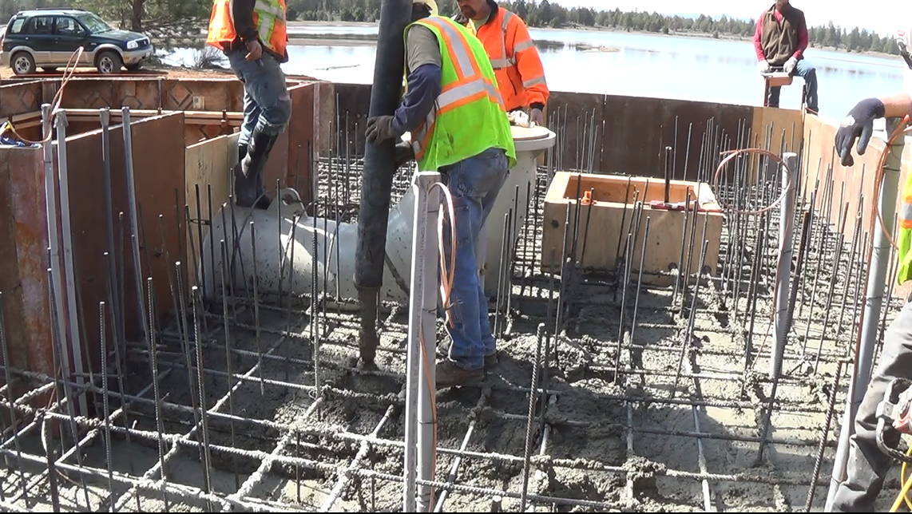
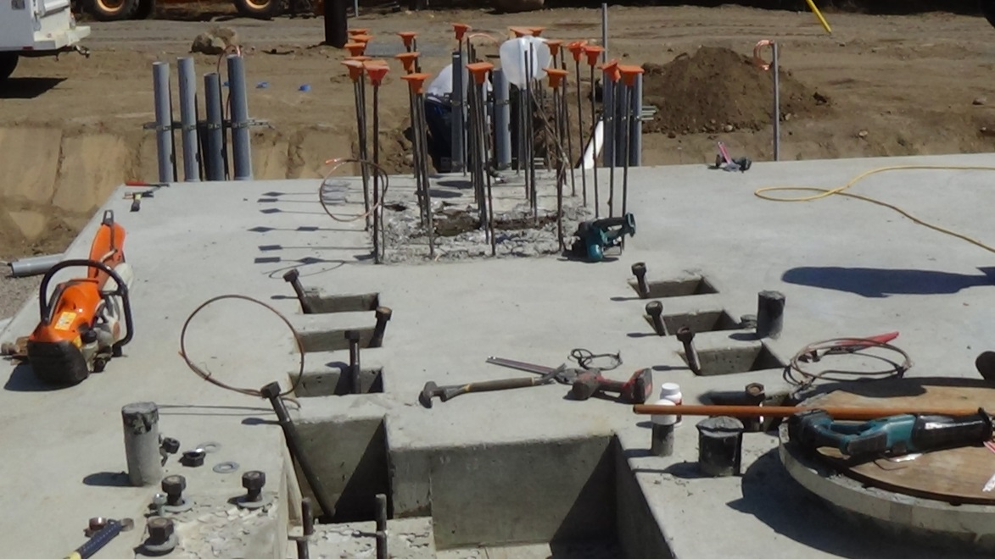
Embedment

Slide 27
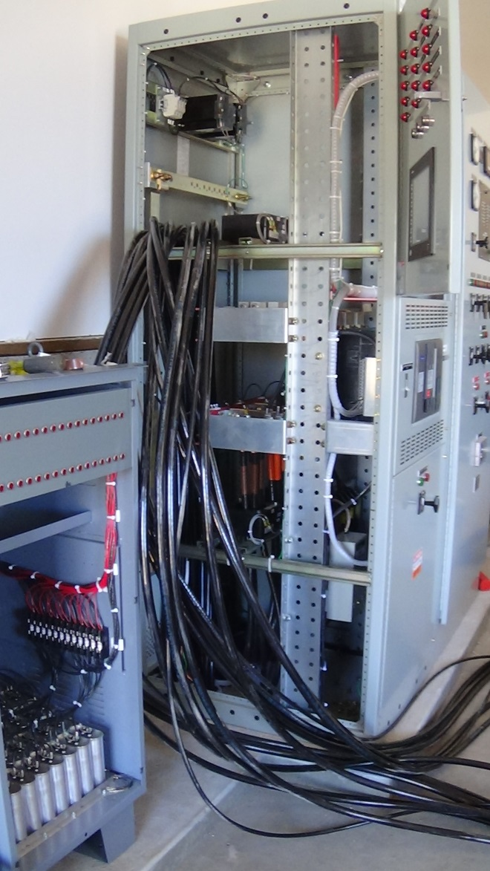
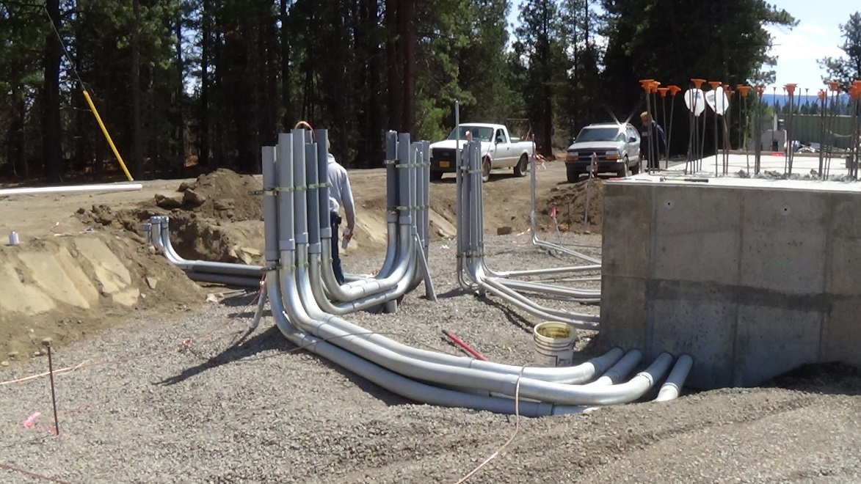
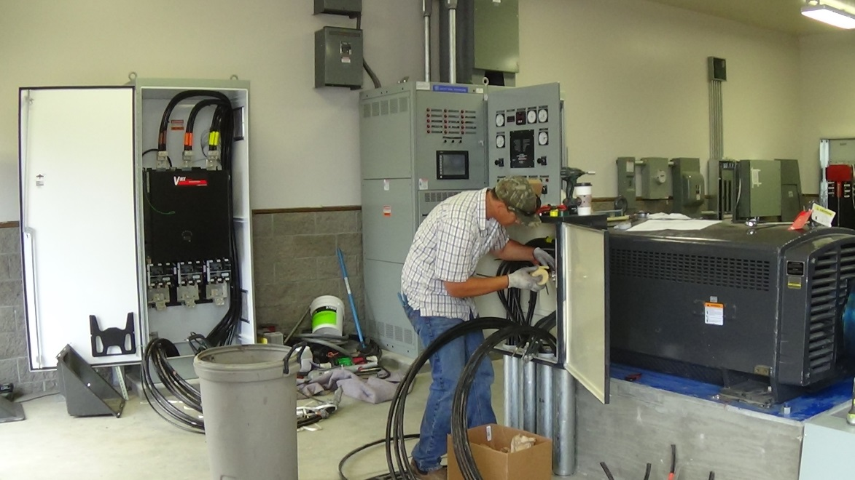
Electrical Controls

Slide 28
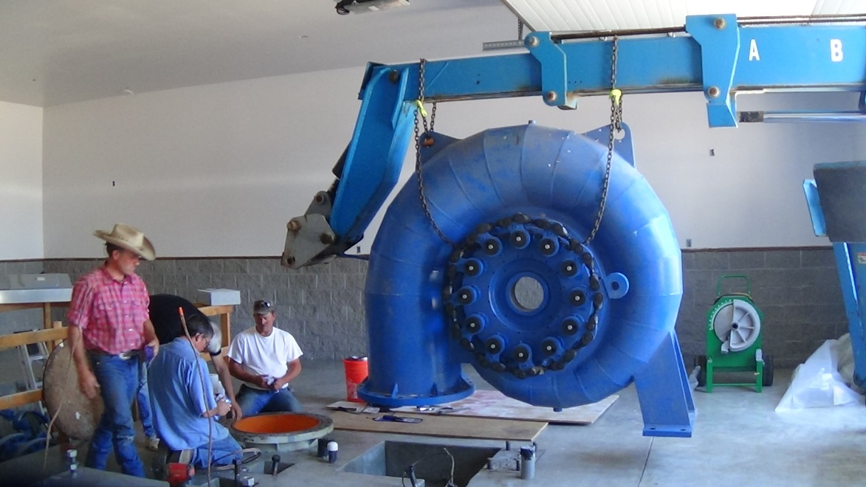
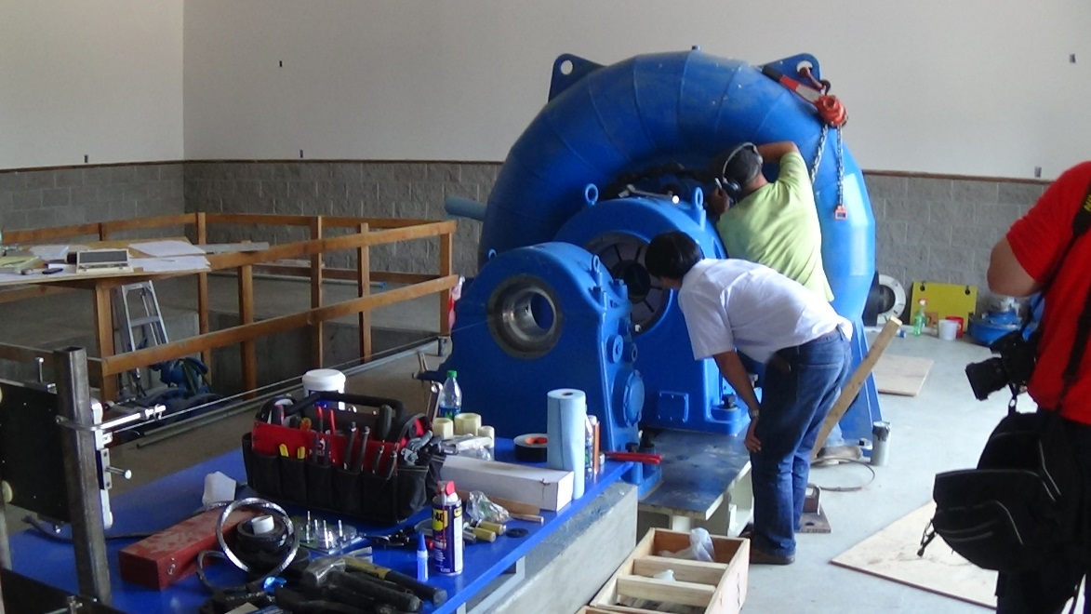
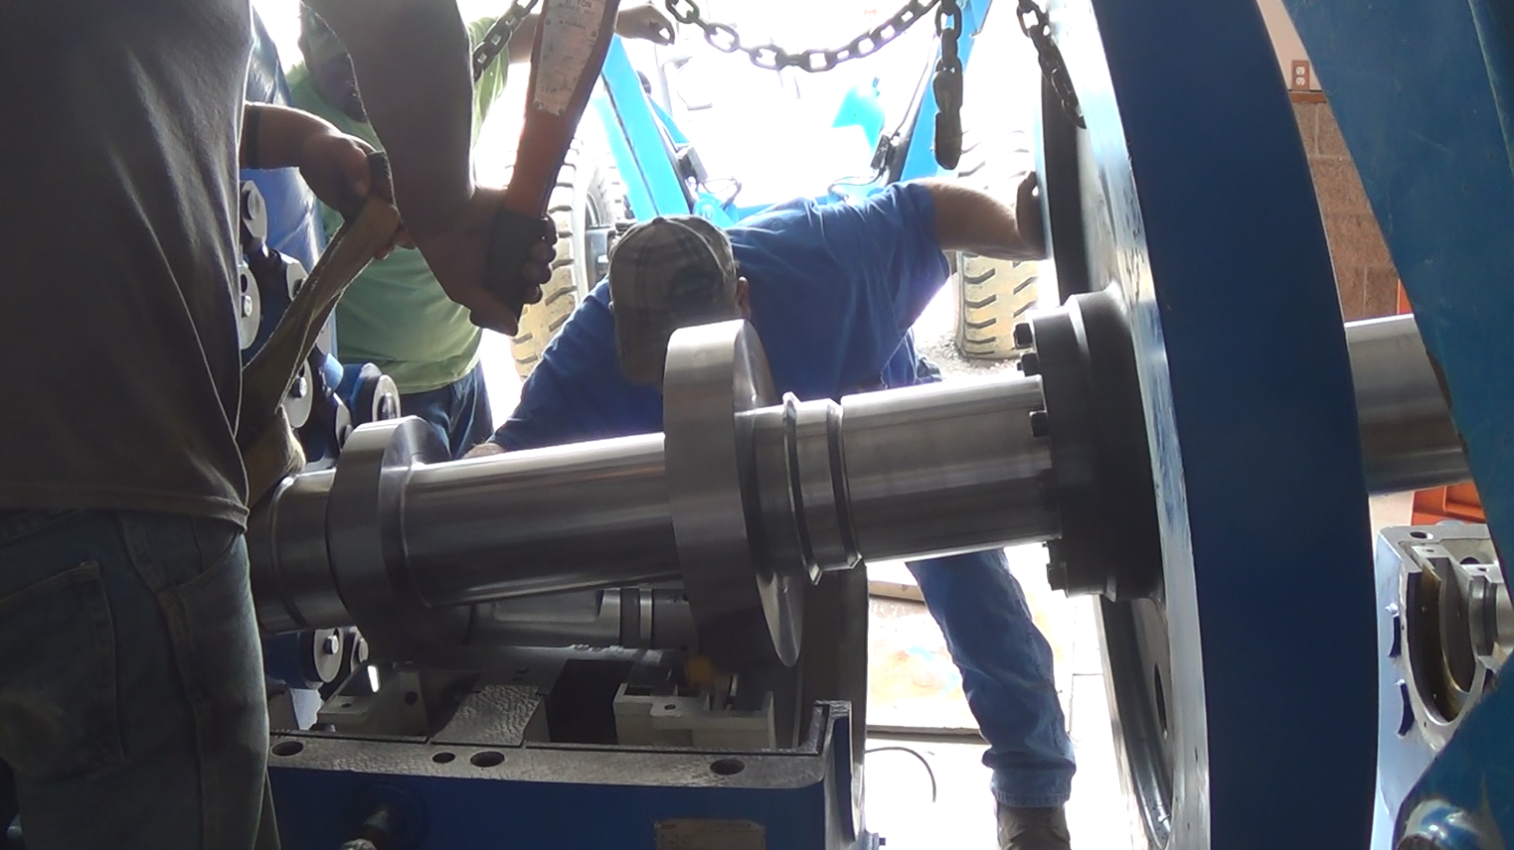
Mechanical Installation

Slide 29
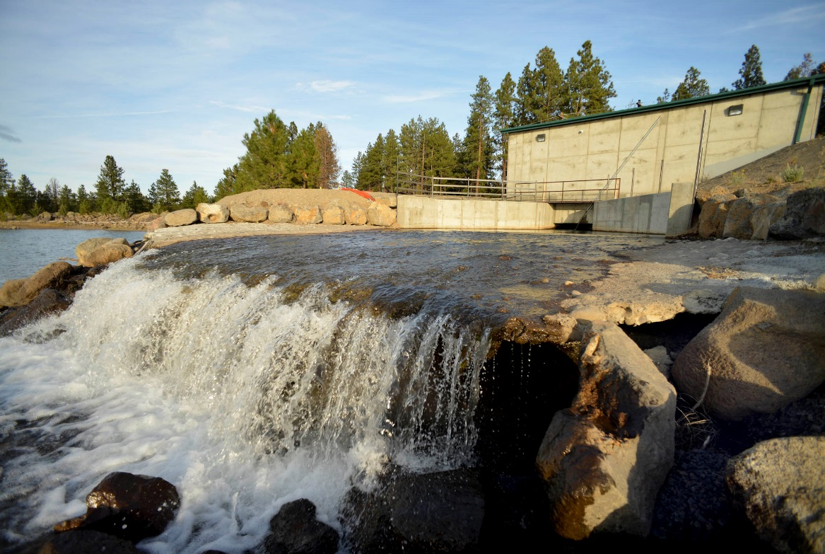
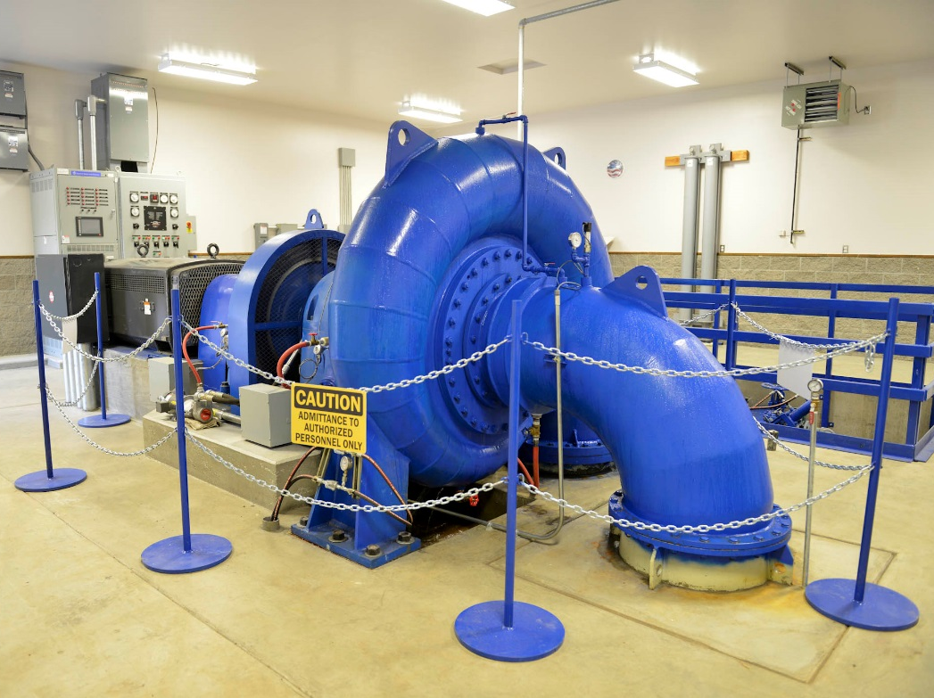
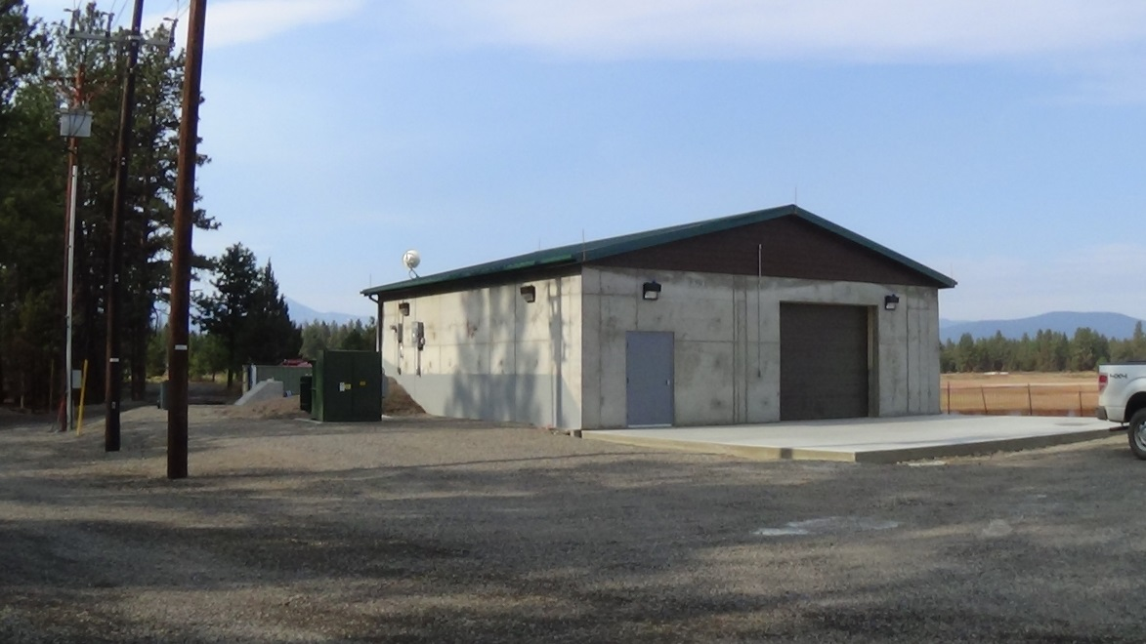
Powerhouse

Slide 30
Benefits
Water Conservation – Elimination of existing canal seepage and evaporation. On Farm deliveries increased by 25% when water was short.
Augmented in-stream flows in Whychus Creek benefits Redband and Bull Trout, Chinook and Steelhead. Completion brings 35 cfs of protected flow.
Fish Conservation. State of the art Farmer’s Conservation Fish Screen.
Improved control of water in conveyance and delivery system. All 193 farms will be metered.
Reduction of operational losses and safety issues. (Canal Breeching)
Pressurization of delivery to irrigators.
Electrical power conservation. Over 9 million kWh conserved annually.
Three Hydro facilities generating clean, green, renewable energy, generating 4 million kWh annually.
Increased economic inputs into the local community. Currently TSID’s farmers are spending an additional $1-2 million dollars annually with delivery of pressurized water on farm.
As of 2020 TSID will be carbon neutral with the energy generation, conservation and crops grown.

Slide 31
Conceptual Project Design
Net Meter / Micro-Hydro Demonstration Project

Slide 32
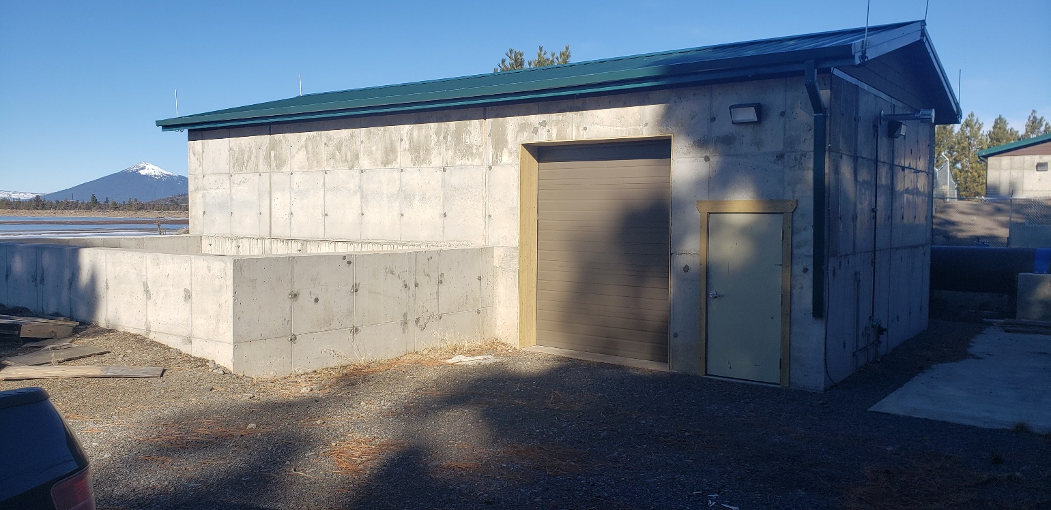
Net Meter/Micro Hydro Demonstration Project

Slide 33
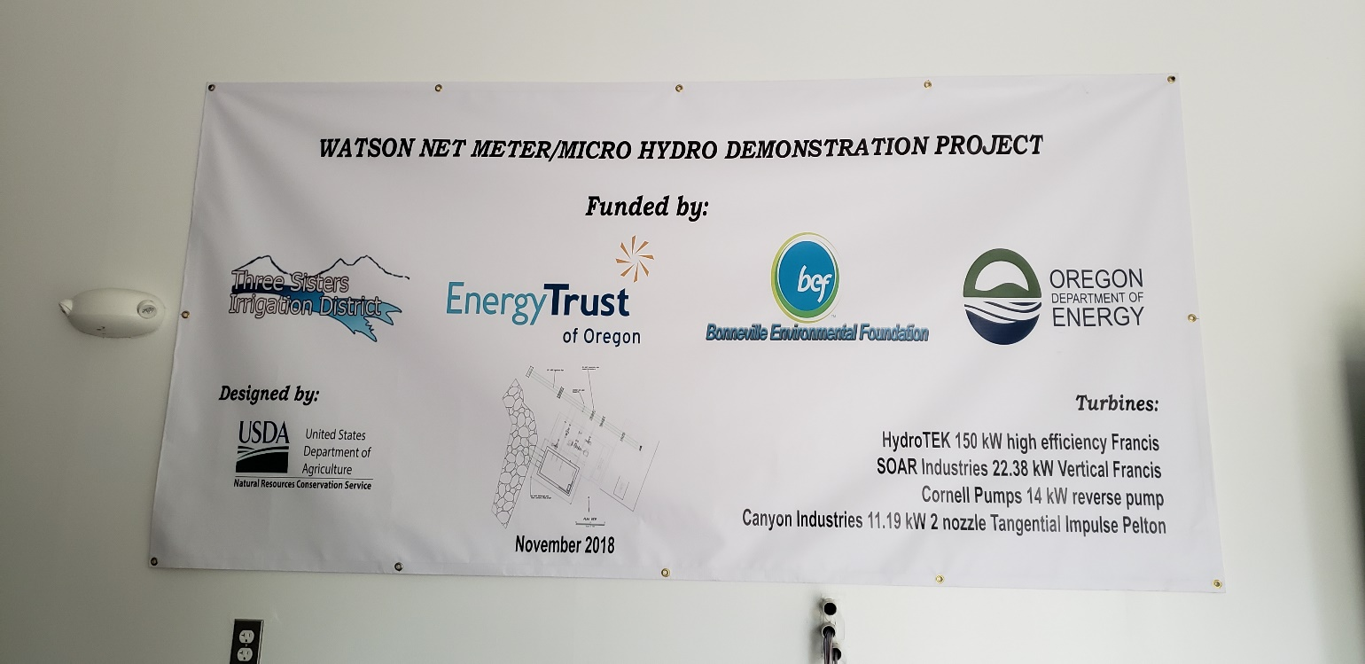
Project Funding

Slide 34

150 kW Horizontal Francis
Turbine

Slide 35

22.38 kW Vertical Francis Turbine

Slide 36

14 kW Reverse Pump

Slide 37

11.19 kW 2 Nozzle Tangential
Impulse Pelton

Slide 38

McKenzie Reservoir
300 kW Hydro

Slide 39

McKenzie Hydro Approach Pipe

Slide 40

Partnerships & Funding

Slide 41
https://vimeo.com/326359384

