Slide 1

Cooperation & Collaboration
How a Little Central Oregon Irrigation District
Got to See a Miracle Happen
Marc Thalacker
Three Sisters Irrigation District

Slide 2









Cooperative Partnership Goals
Water Conservation
Energy Conservation
Carbon Footprint Reduction
Sustainable Agriculture
Anadromous Re-introduction
Stream Restoration
Made Possible by Statute

Slide 3
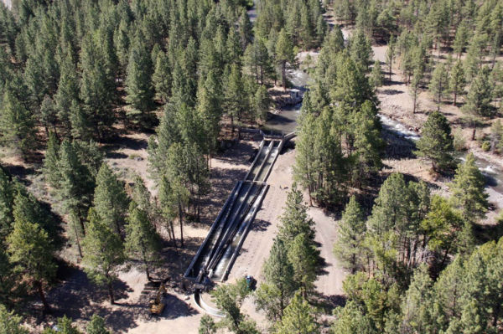
Completed Fish Screen

Slide 4
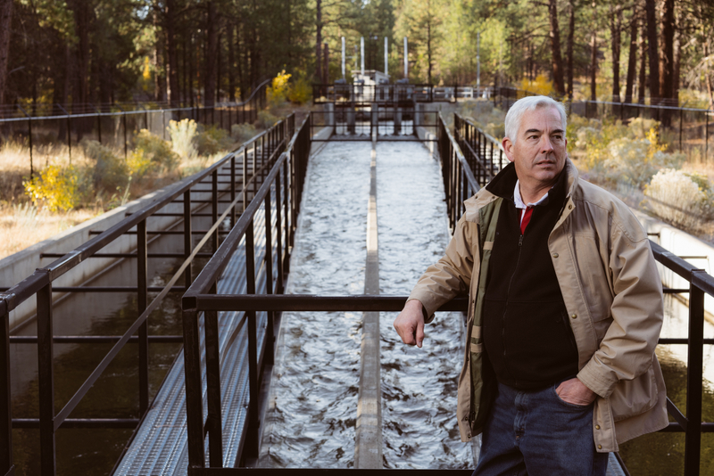
No Moving Parts or Power

Slide 5
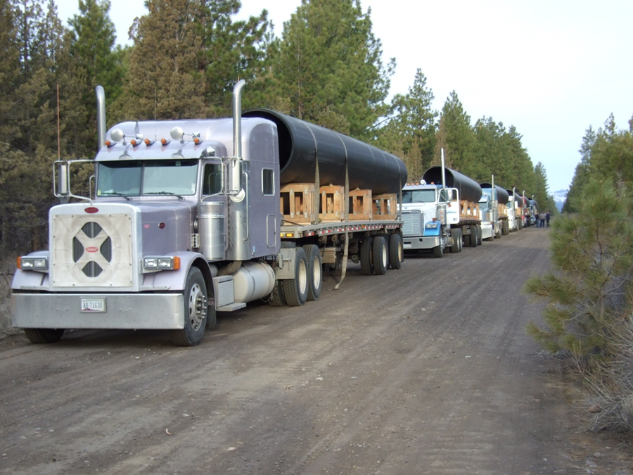
Trucks Arrive with HDPE

Slide 6
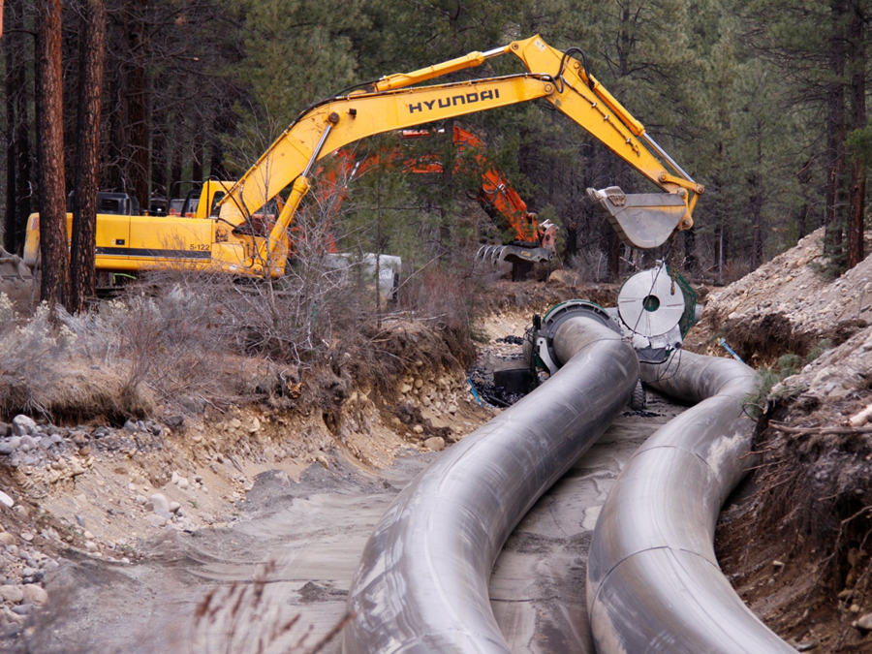
Double S Turn

Slide 7
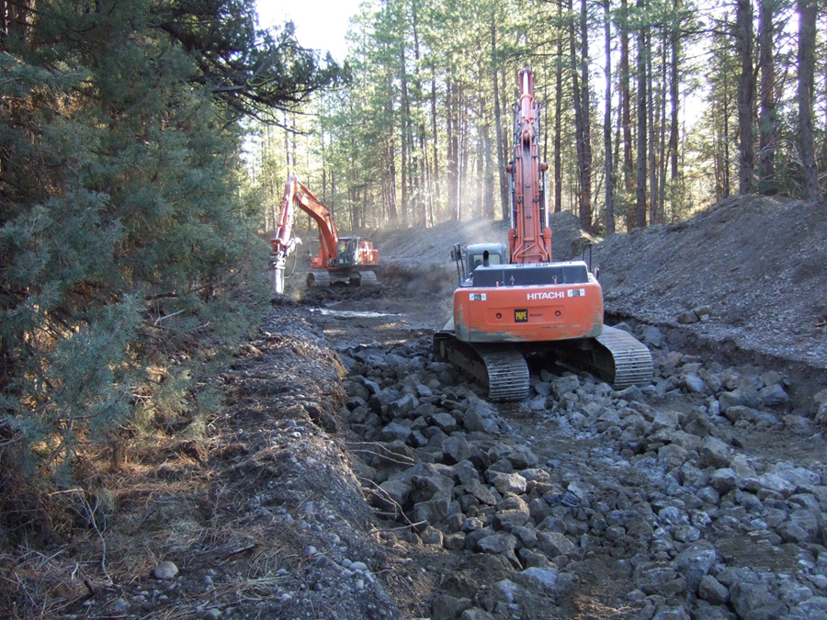
Obstacles

Slide 8
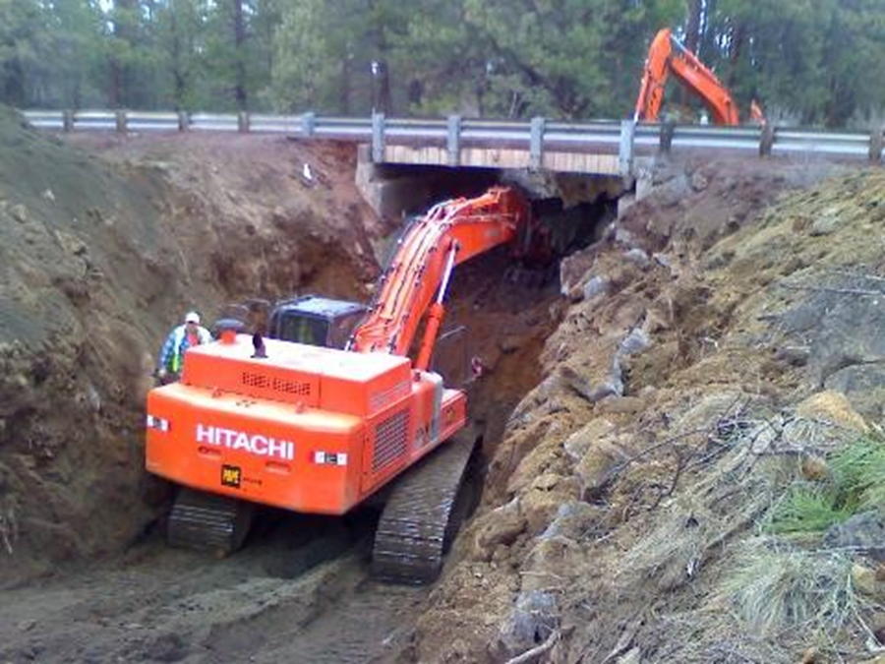
Highway 20 Bridge

Slide 9
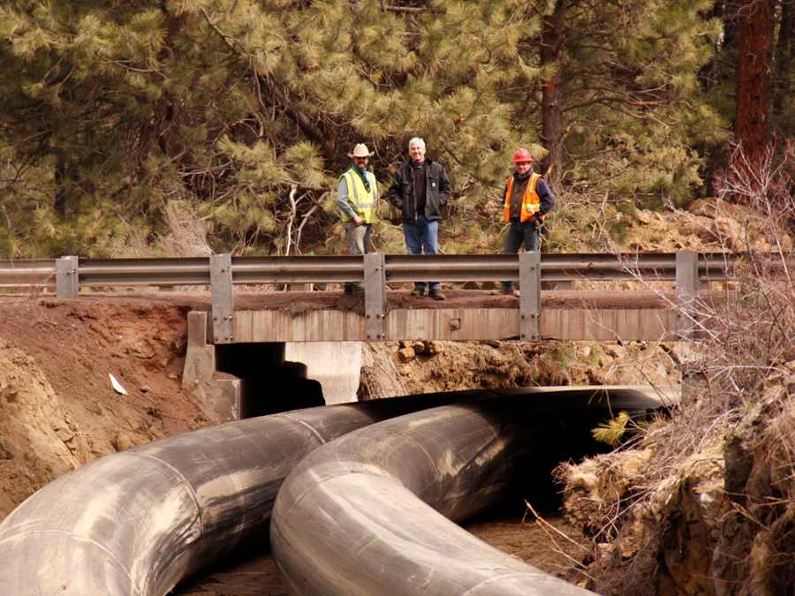
ODOT Retires Bridge Over Canal

Slide 10
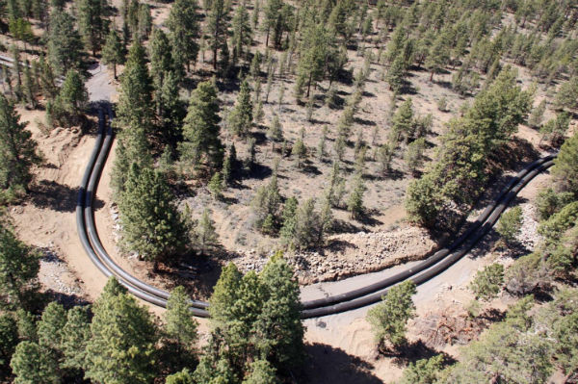
Penstock
Notes:
Done in 3 phases.

Slide 11
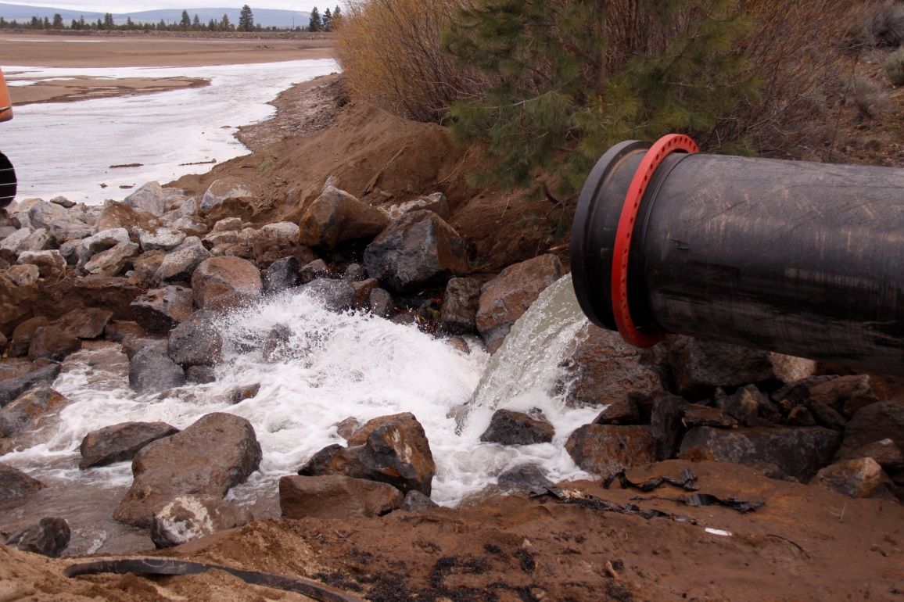
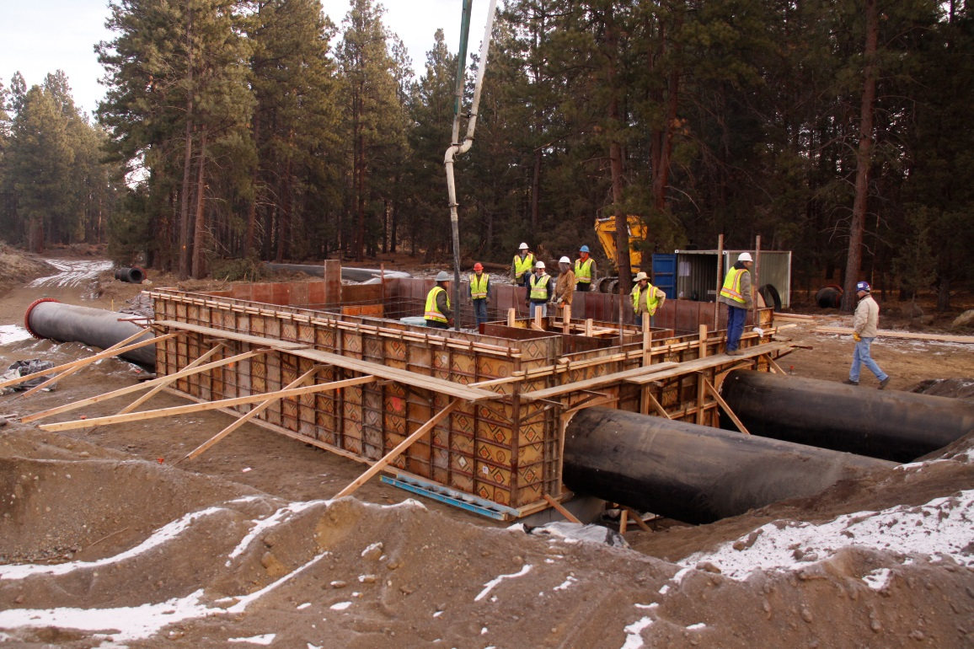
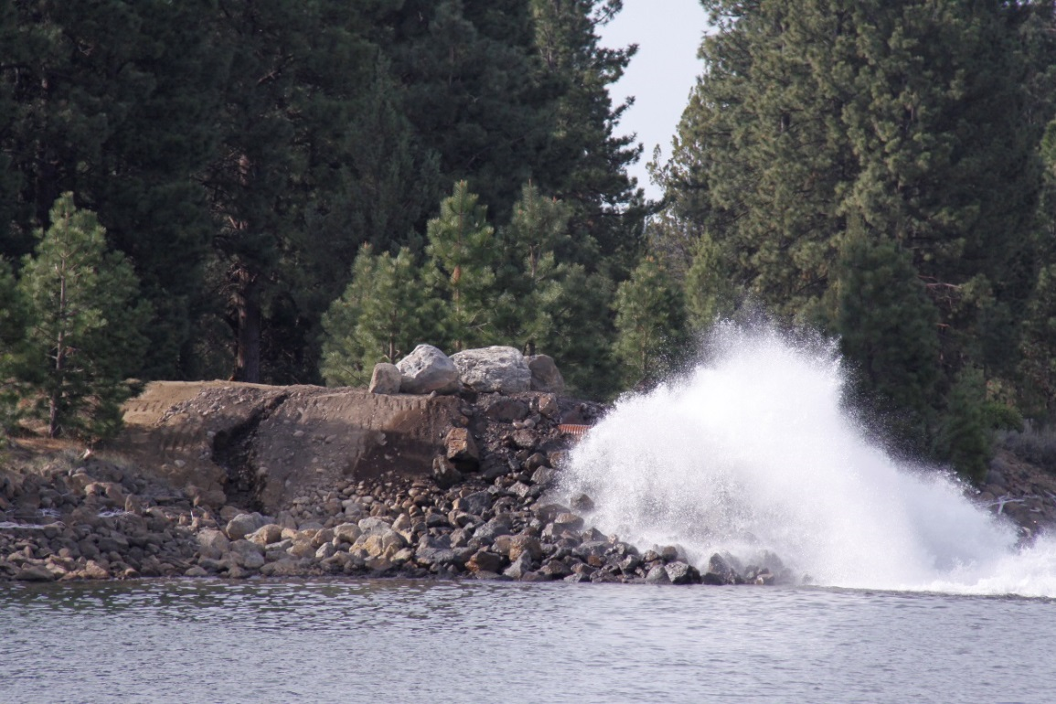
Penstock at Powerhouse Site

Slide 12
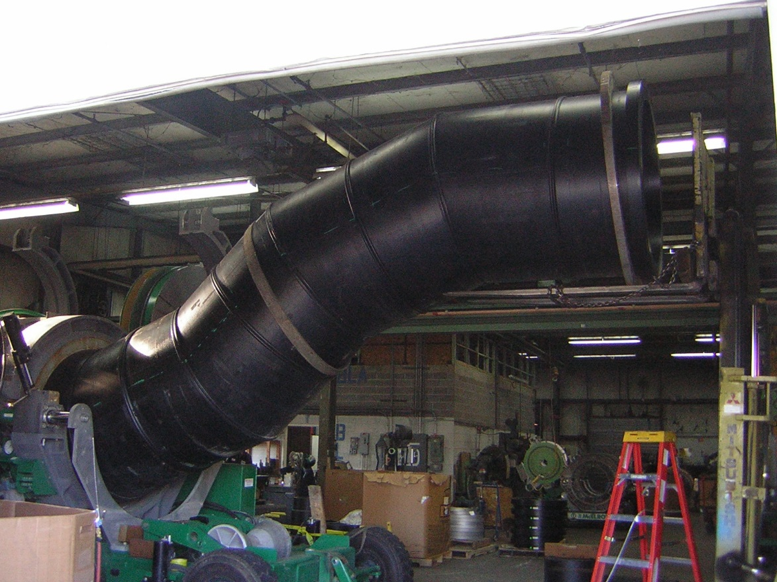
Z-Pipe

Slide 13
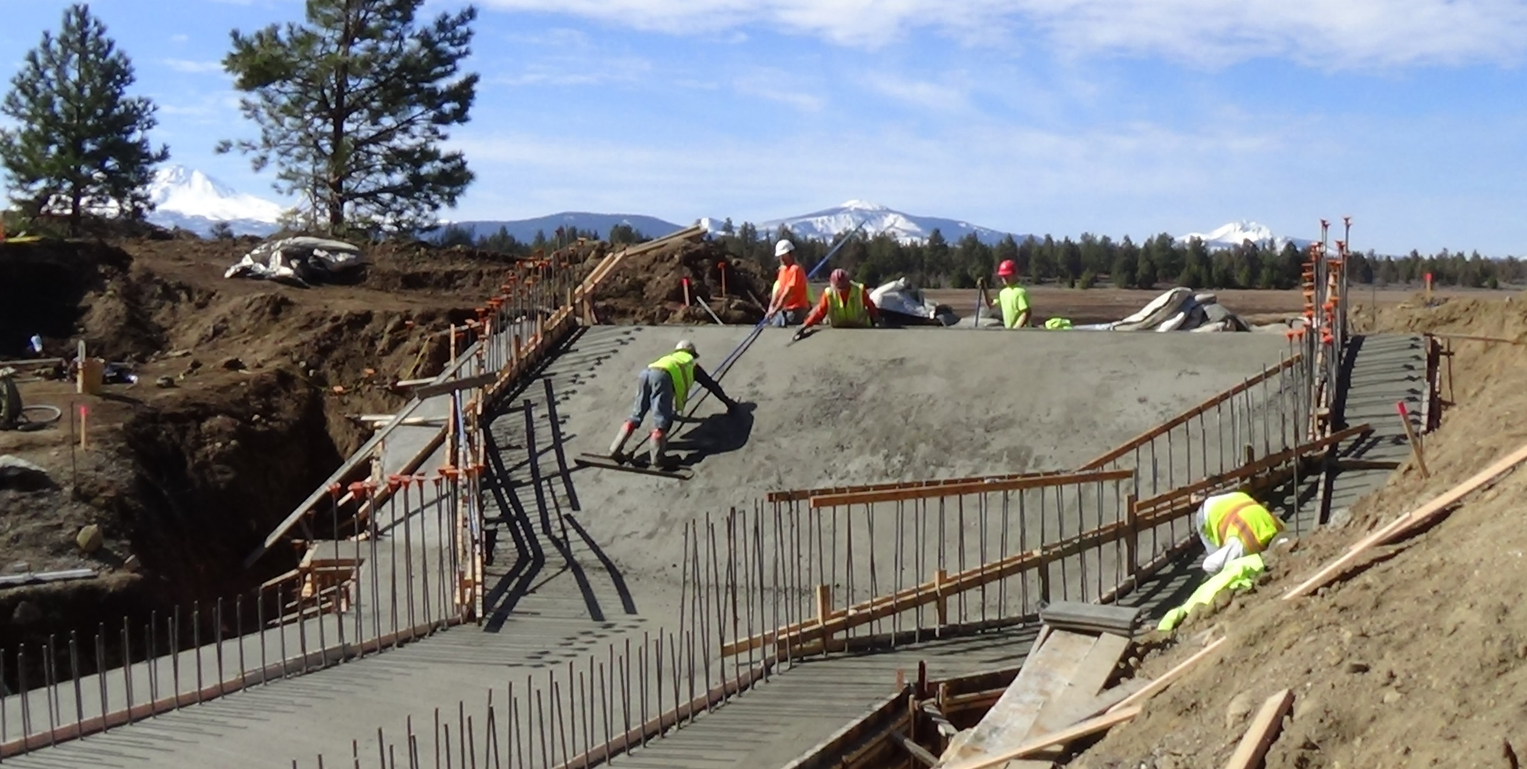
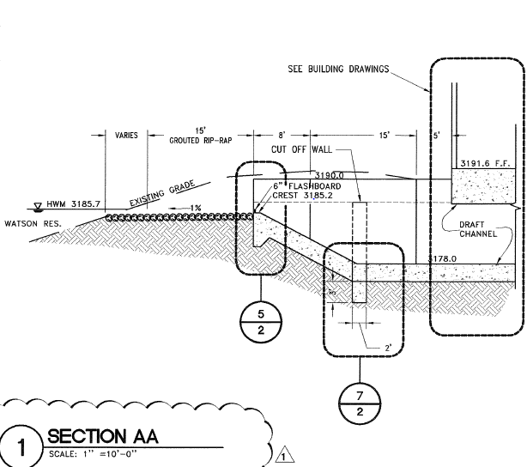
Tailrace

Slide 14
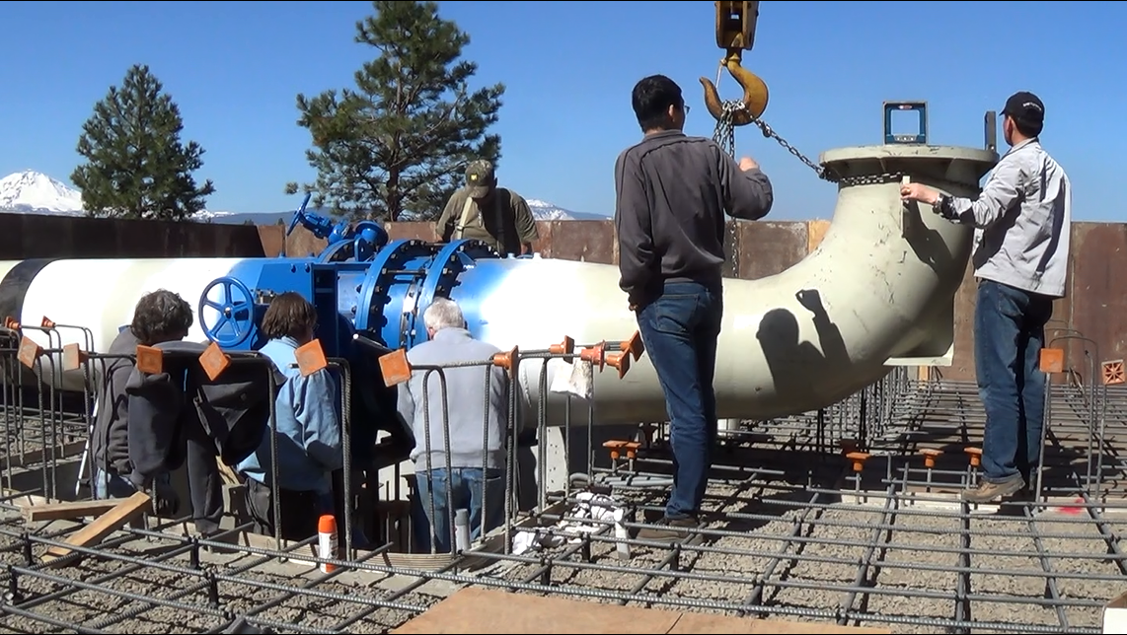
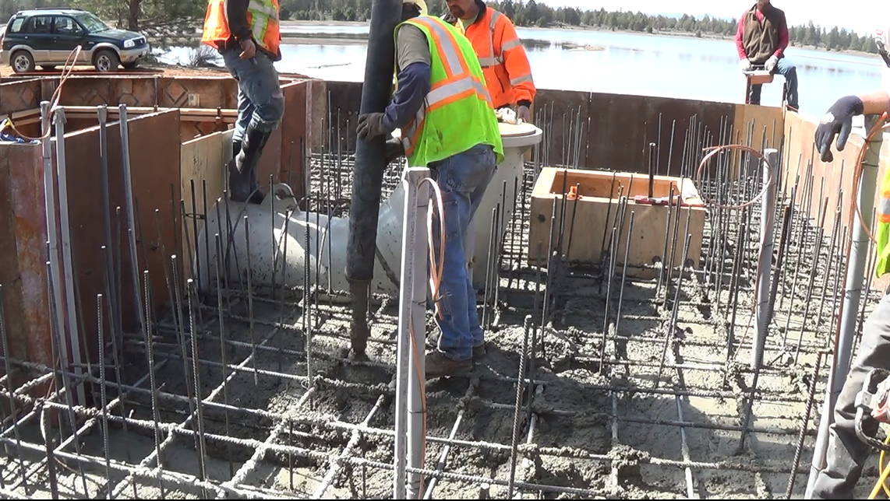
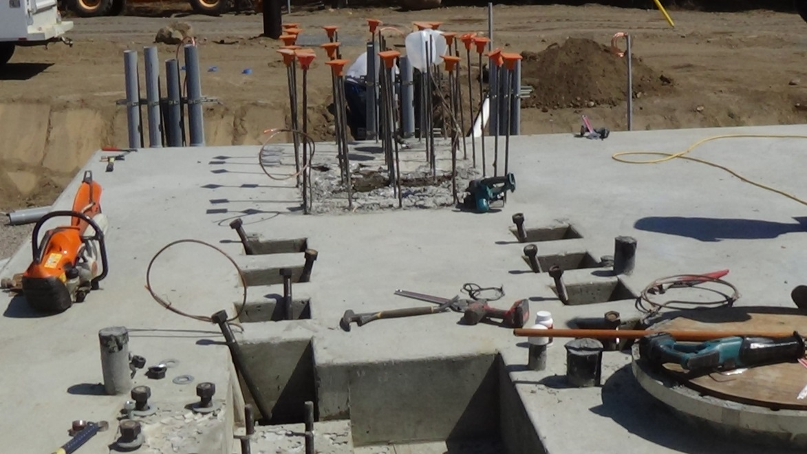
Embedment

Slide 15
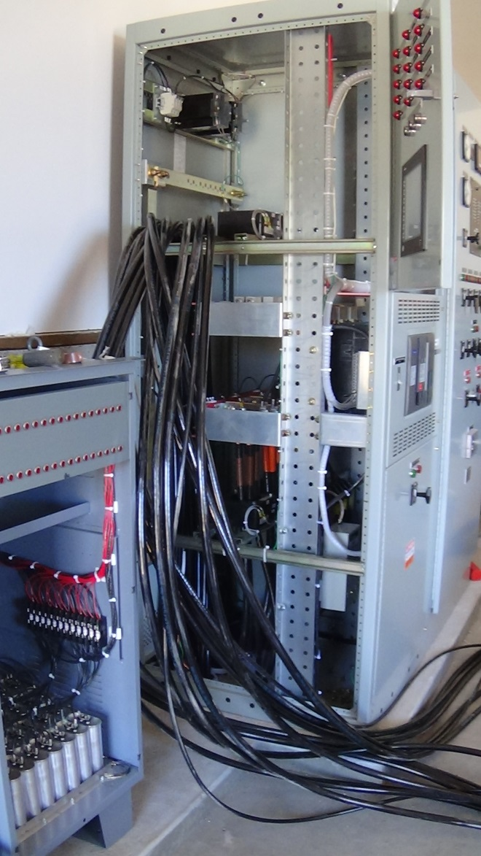
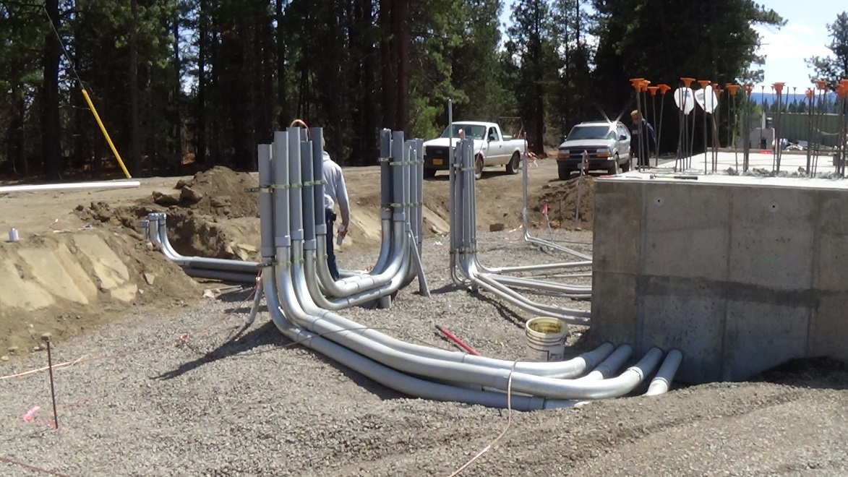
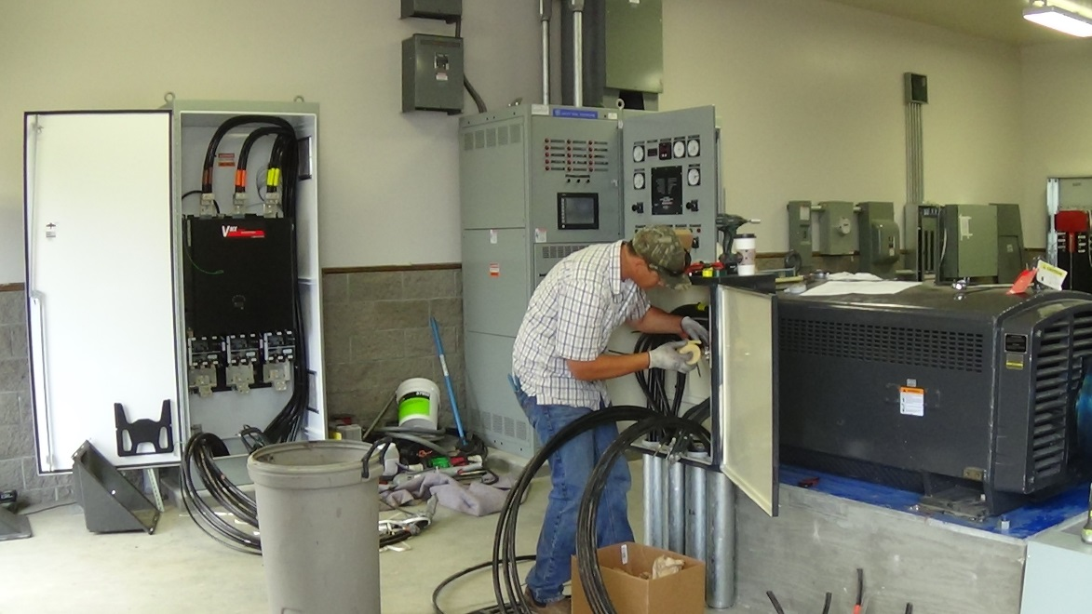
Electrical Controls

Slide 16
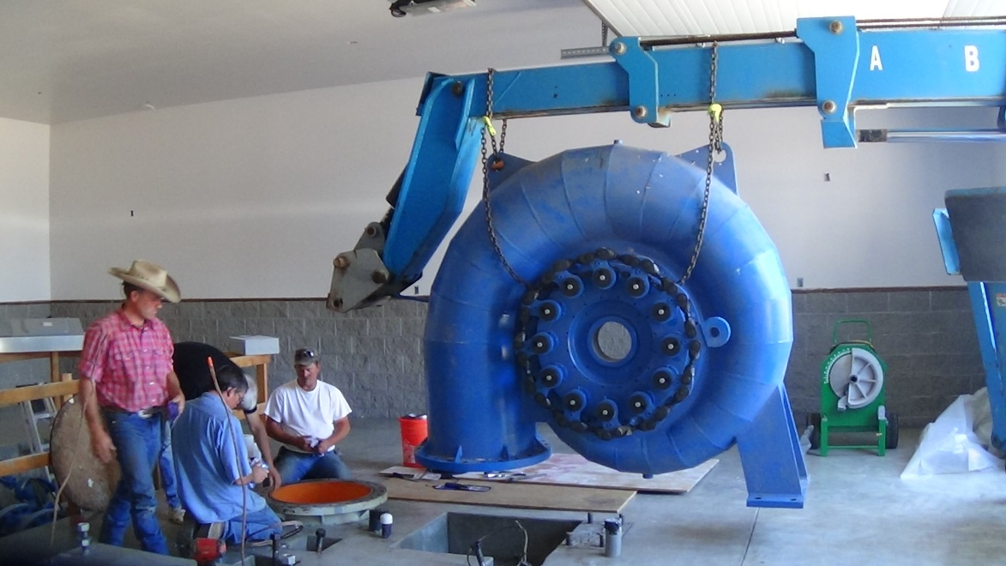
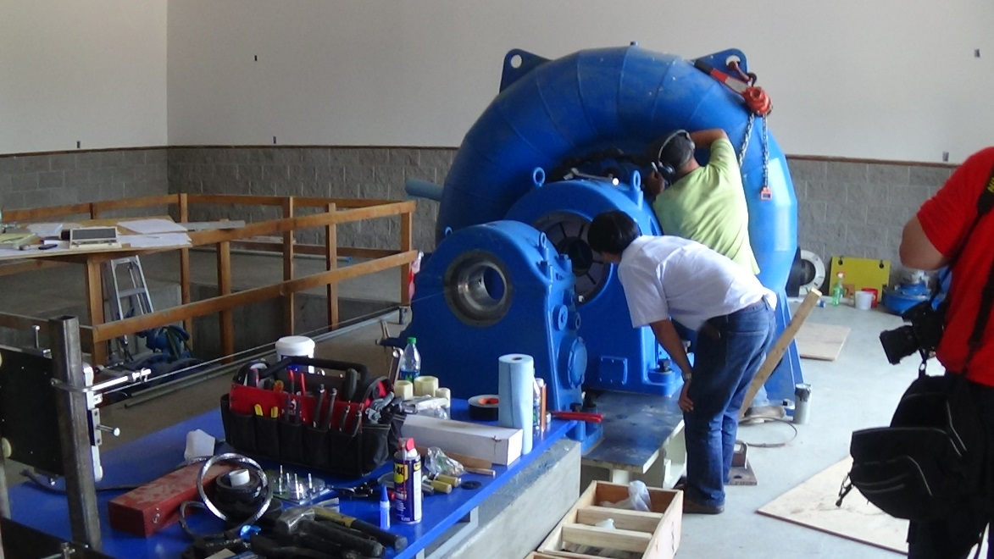
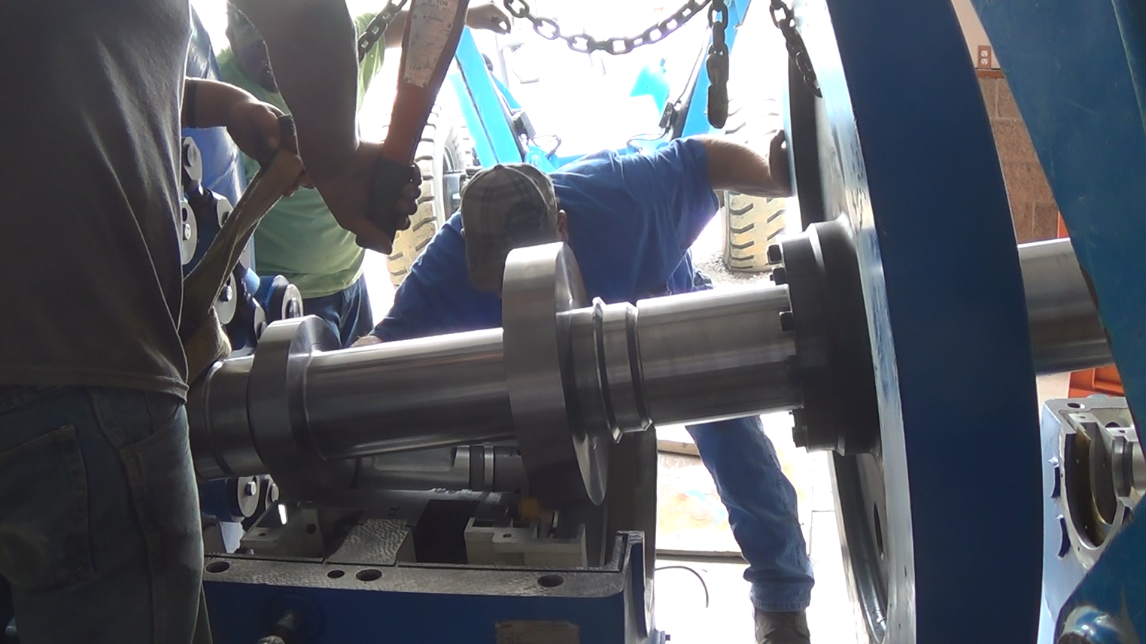
Mechanical Installation

Slide 17
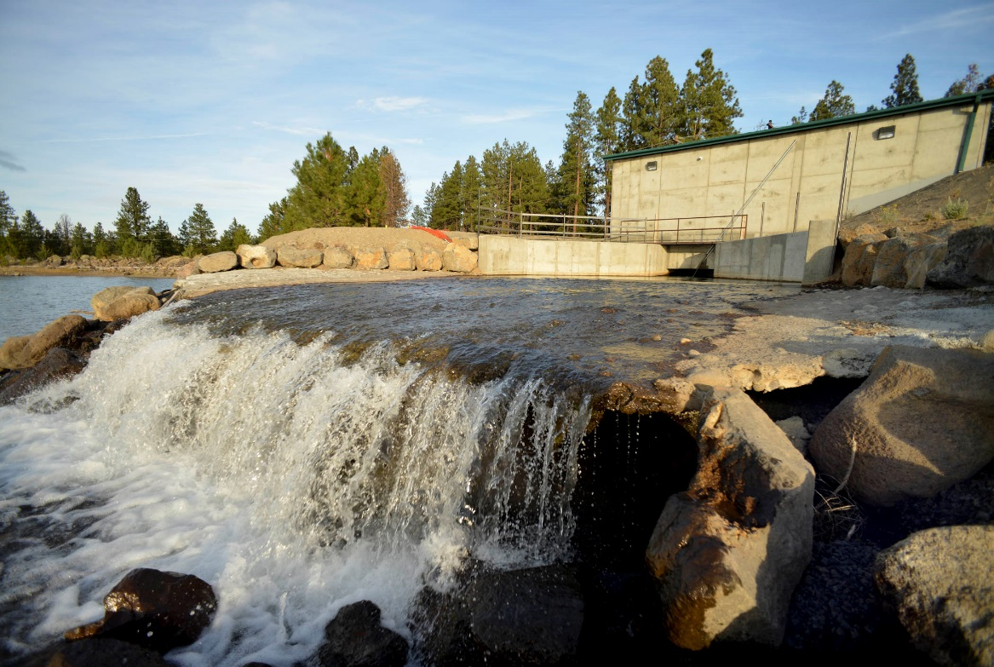
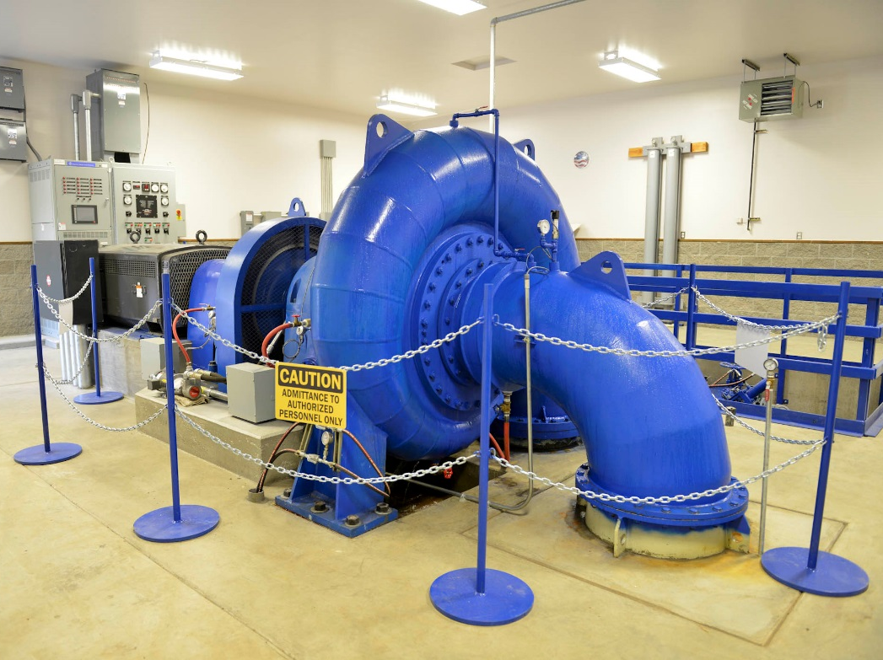
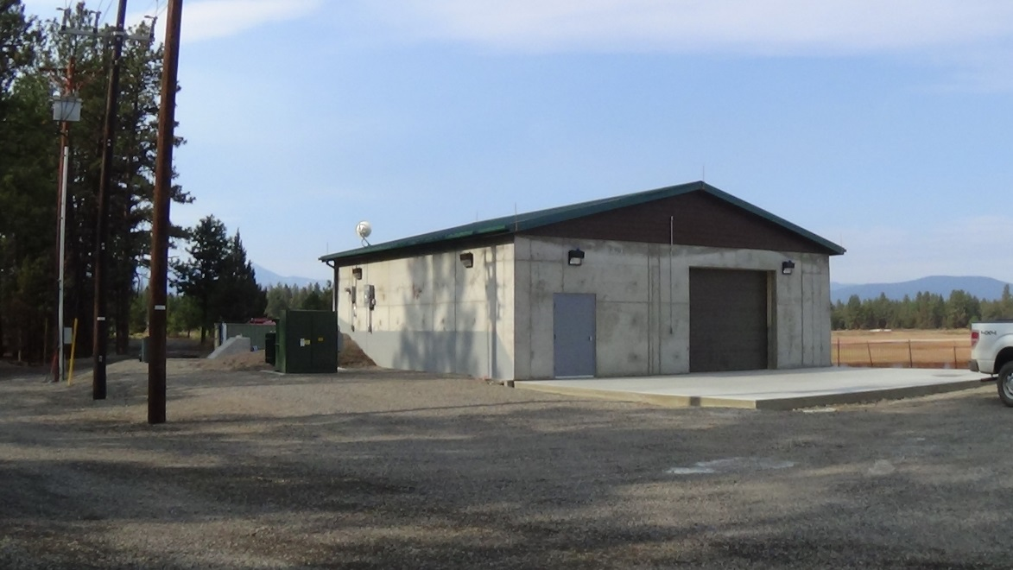
Powerhouse

Slide 18
Benefits
Water Conservation – Elimination of existing canal seepage and evaporation. On Farm deliveries increased by 25% when water was short.
Augmented in-stream flows in Whychus Creek benefits Redband and Bull Trout, Chinook and Steelhead. Completion brings 35 cfs of protected flow.
Fish Conservation. State of the art Farmer’s Conservation Fish Screen.
Improved control of water in conveyance and delivery system. All 200 farms will be metered.
Reduction of operational losses and safety issues. (Canal Breeching)
Pressurization of delivery to irrigators.
Electrical power conservation. Over 9 million kWh conserved annually.
Three Hydro facilities generating clean, green, renewable energy, generating 4 million kWh annually.
Increased economic inputs into the local community. Currently TSID’s farmers are spending an additional $1-2 million dollars annually with delivery of pressurized water on farm.
As of 2022 TSID will be carbon neutral with the energy generation, conservation and crops grown.

Slide 19
Conceptual Project Design
Net Meter / Micro-Hydro Demonstration Project

Slide 20
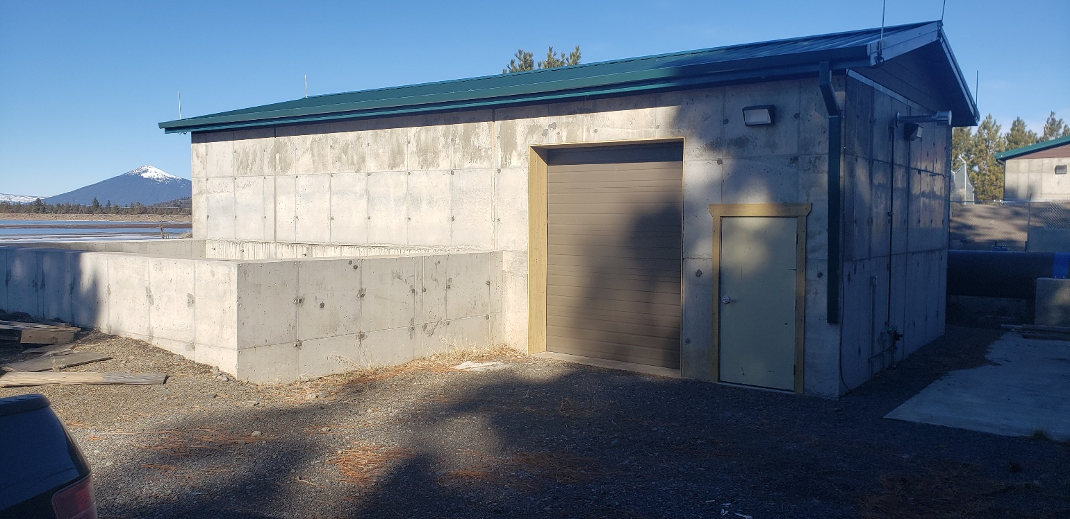
200 kW Net Meter/Micro Hydro Demonstration Project

Slide 21
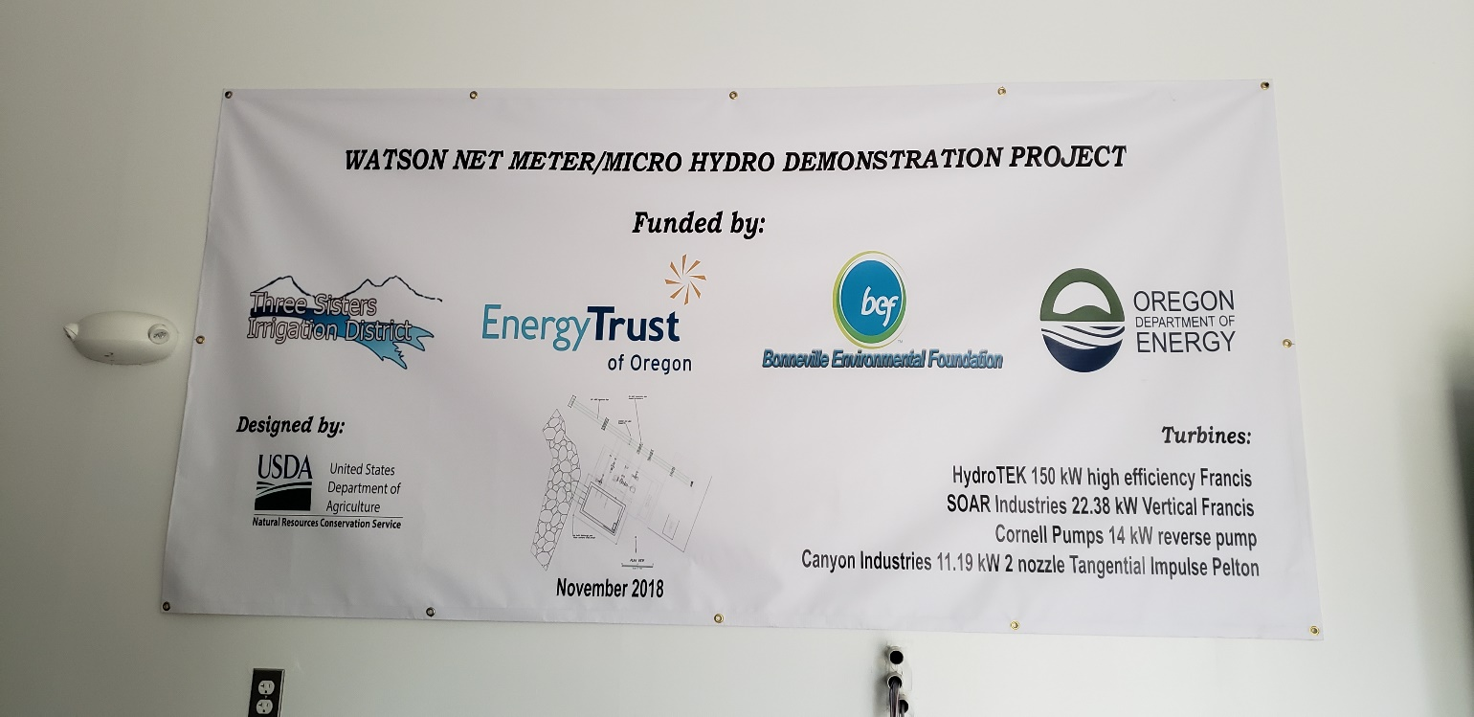
Project Funding

Slide 22
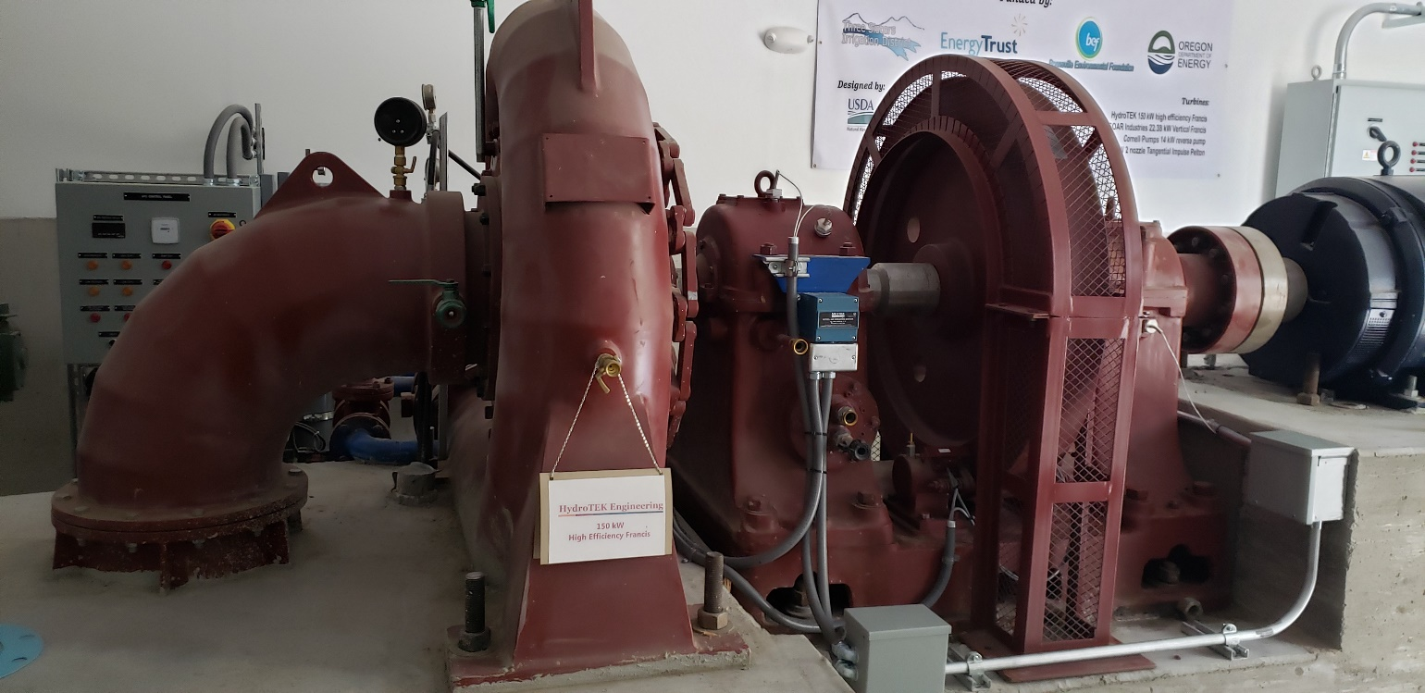
150 kW Horizontal Francis
Turbine

Slide 23
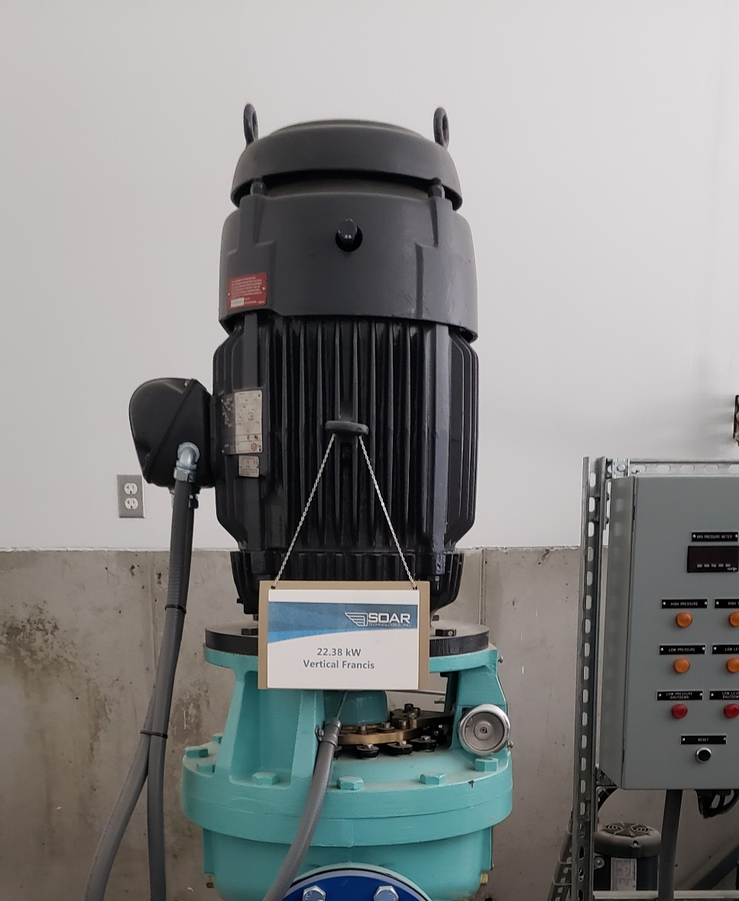
22.38 kW Vertical Francis Turbine

Slide 24
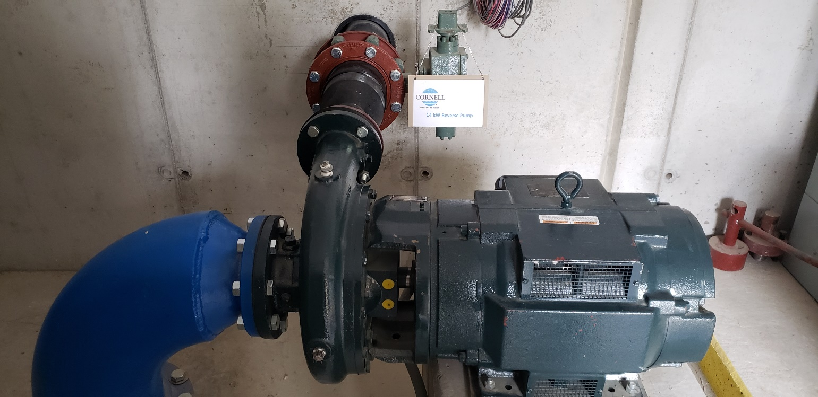
14 kW Reverse Pump

Slide 25
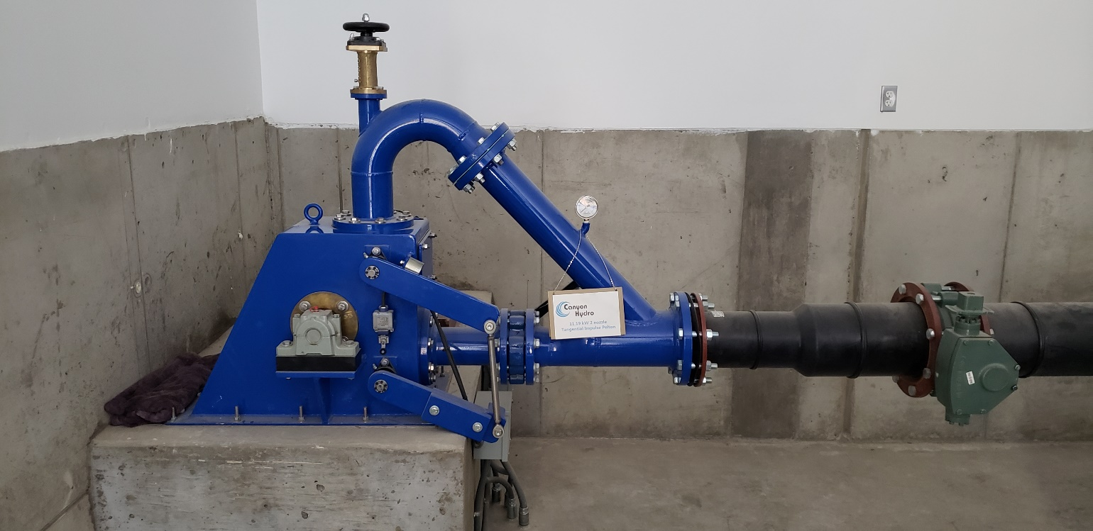
11.19 kW 2 Nozzle Tangential
Impulse Pelton

Slide 26
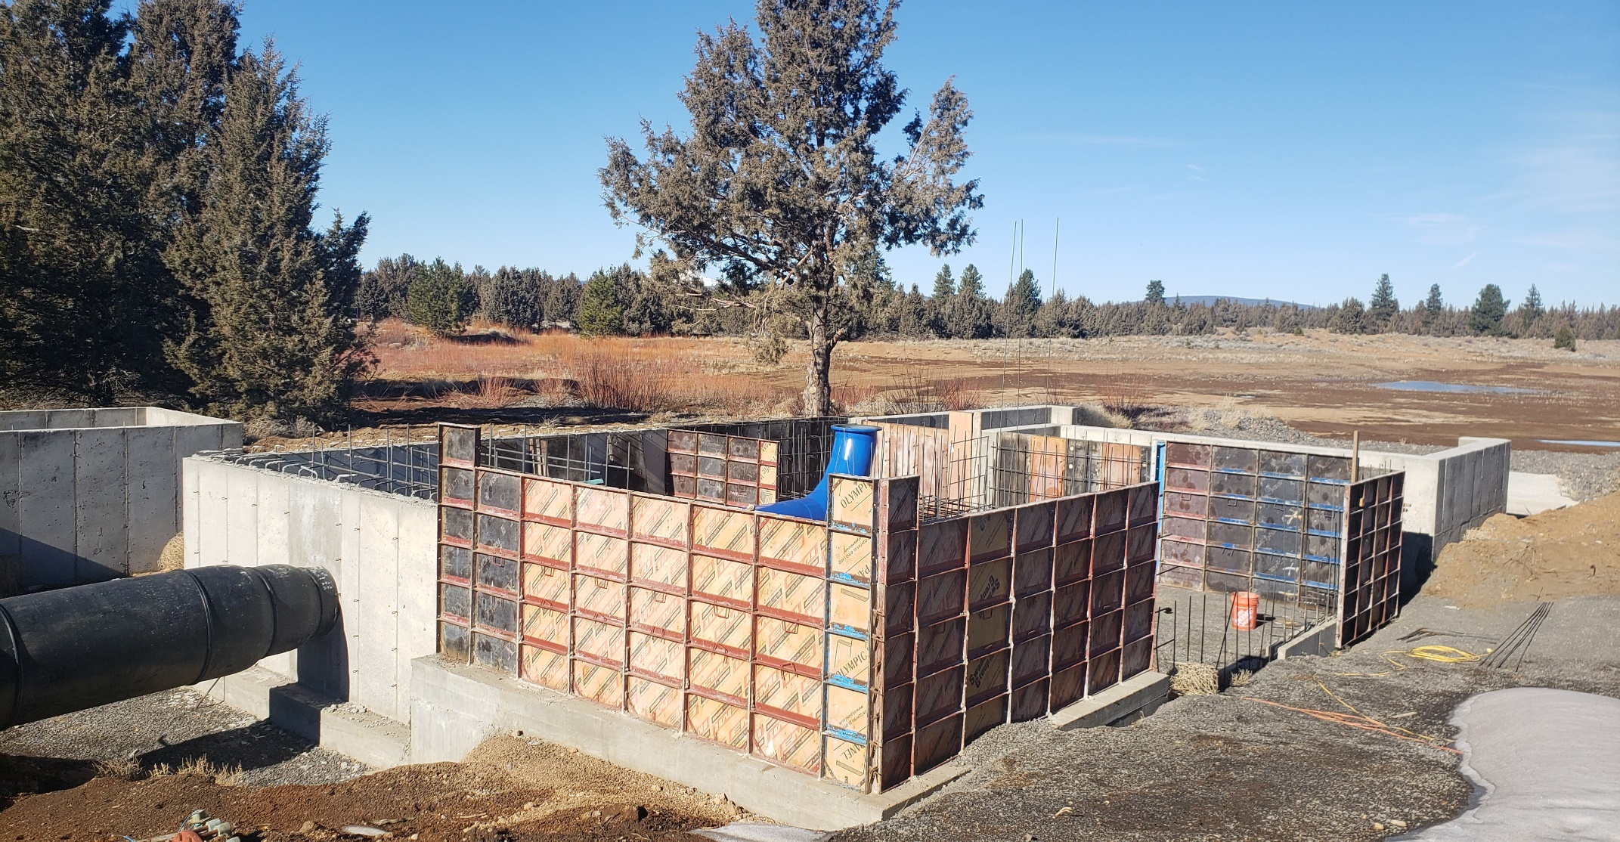
McKenzie Reservoir
300 kW Hydro

Slide 27
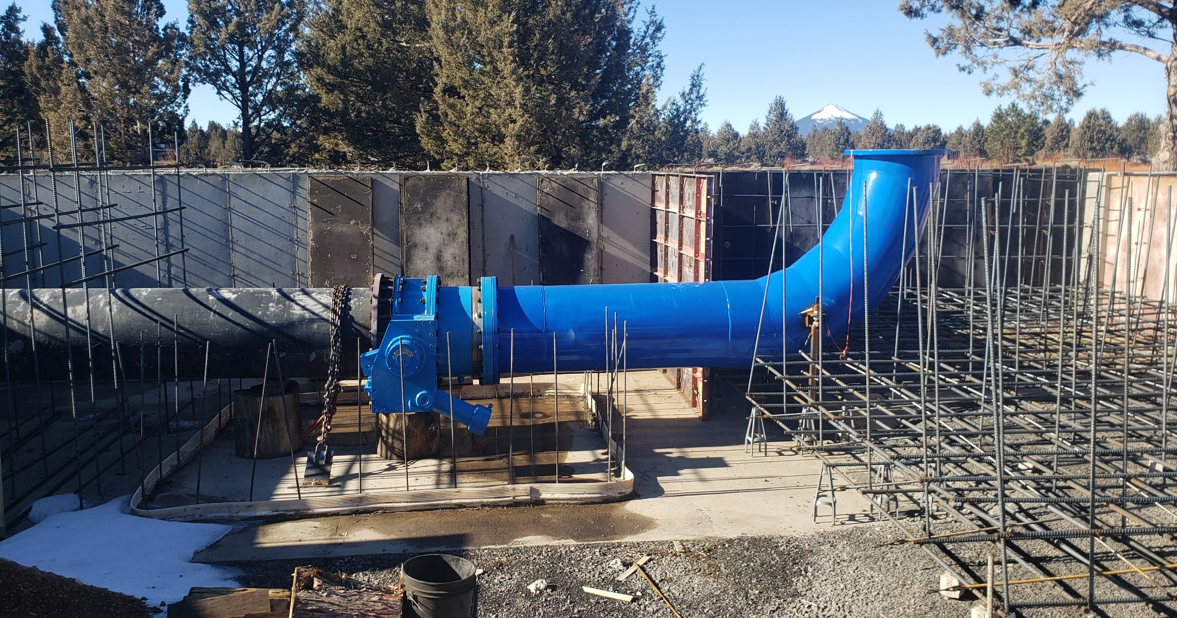
Preparing for Embedment

Slide 28
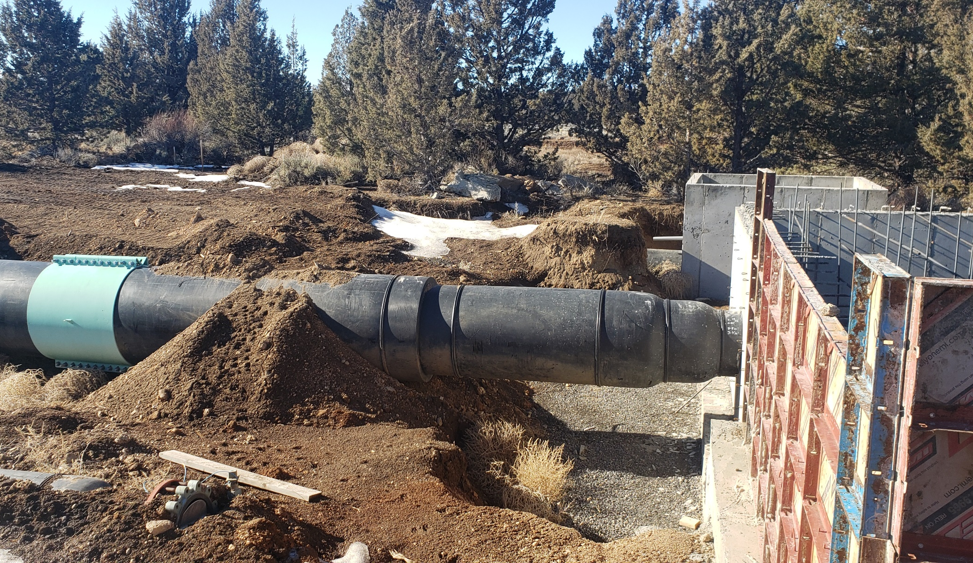
McKenzie Hydro Approach Pipe

Slide 29
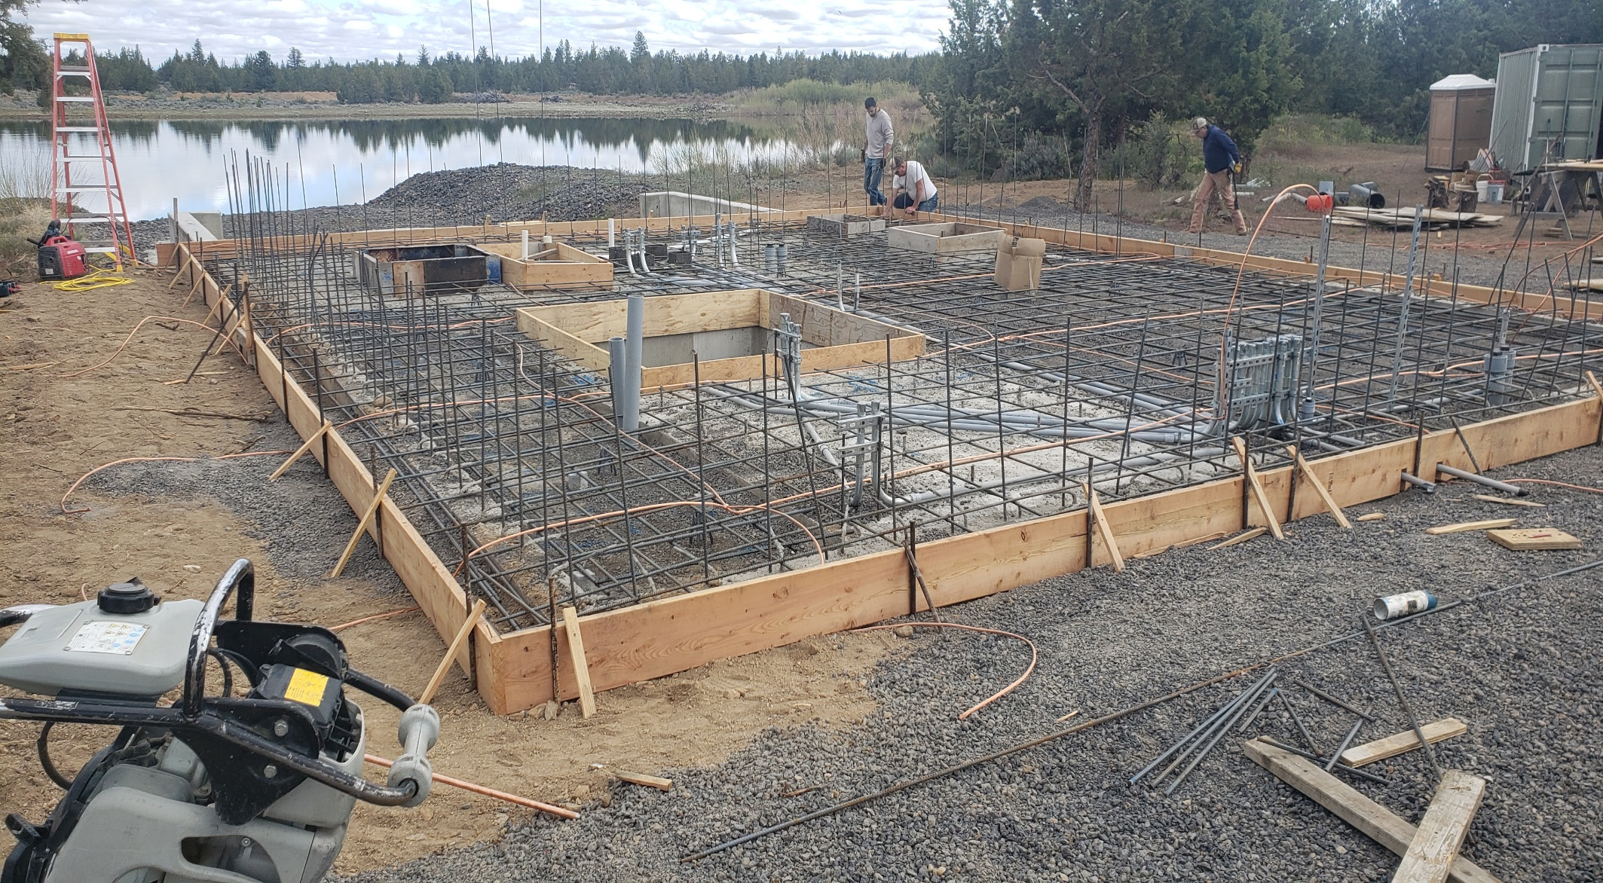
Conduit, Grounding & Forming the Hydro Floor

Slide 30
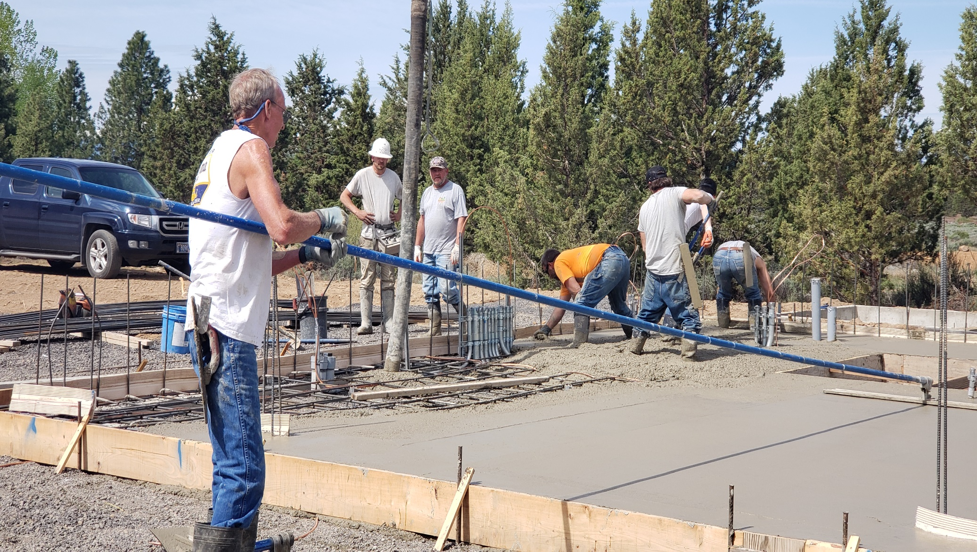
Pouring the floor

Slide 31
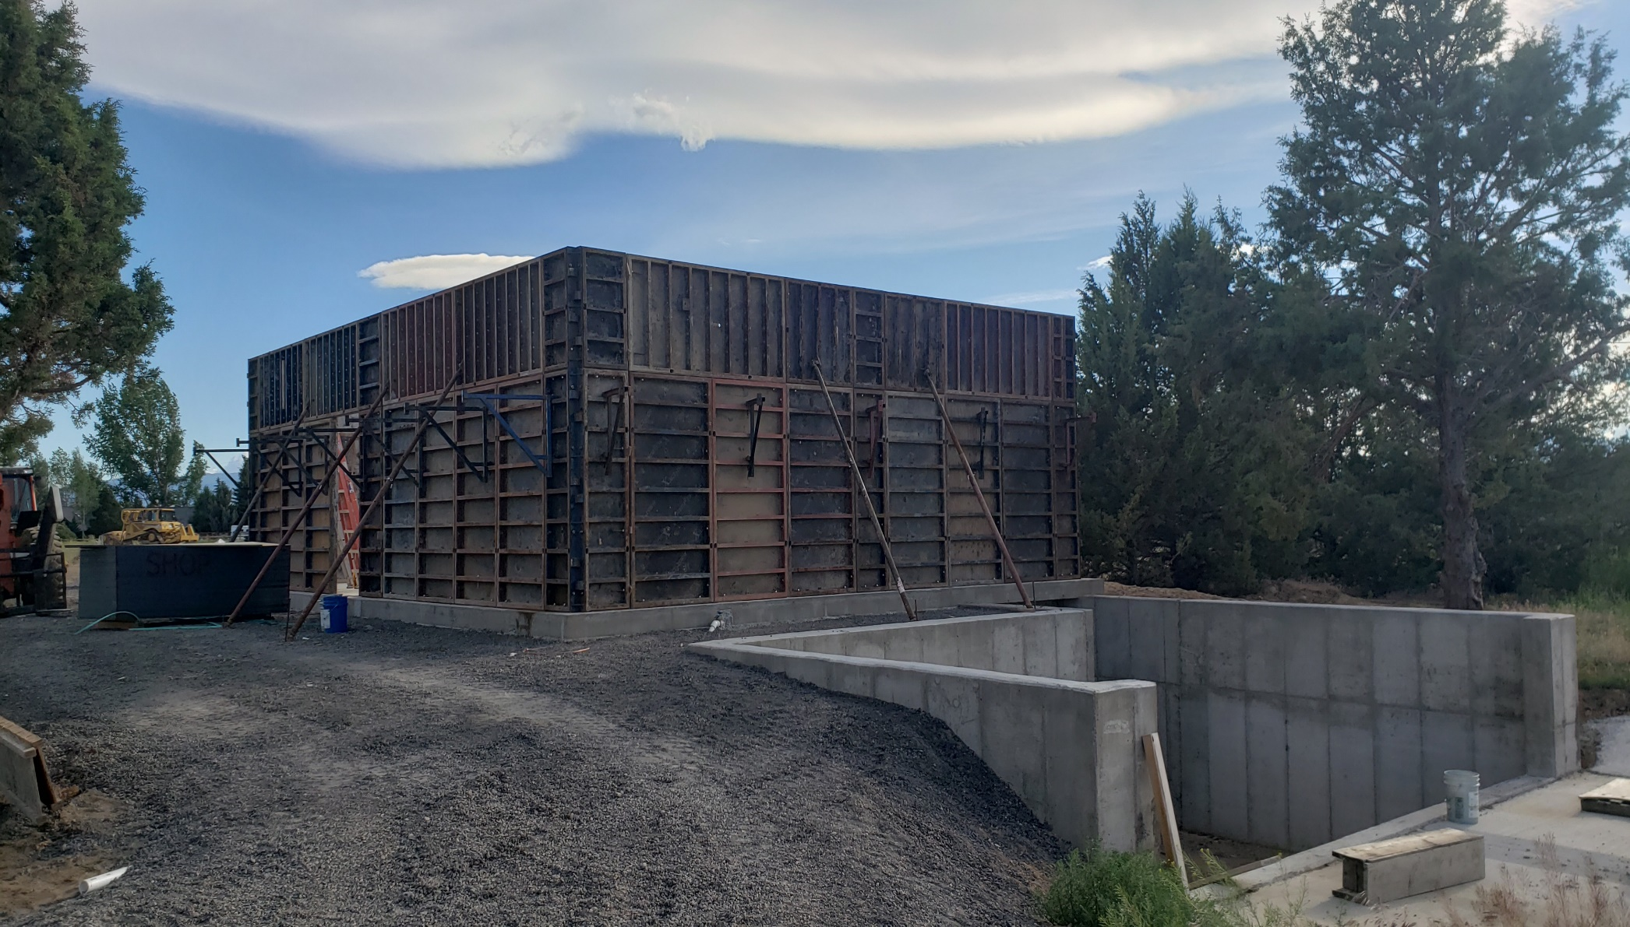
Preparing to pour the building

Slide 32
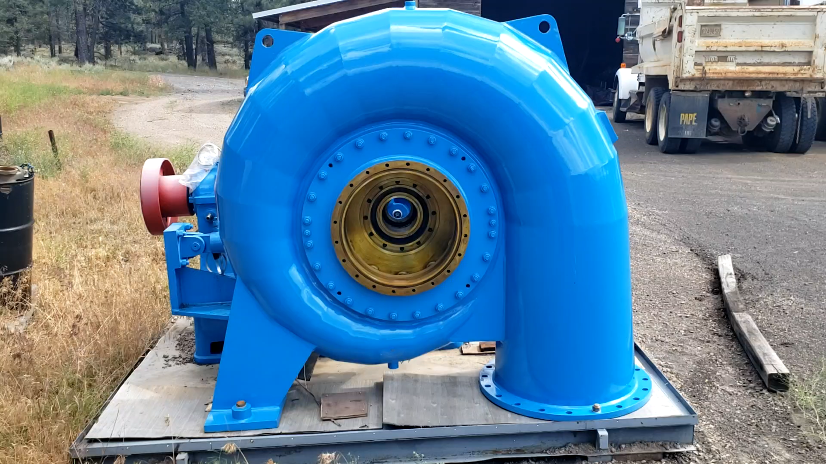
McKenzie 300 kW Scroll Shell

Slide 33
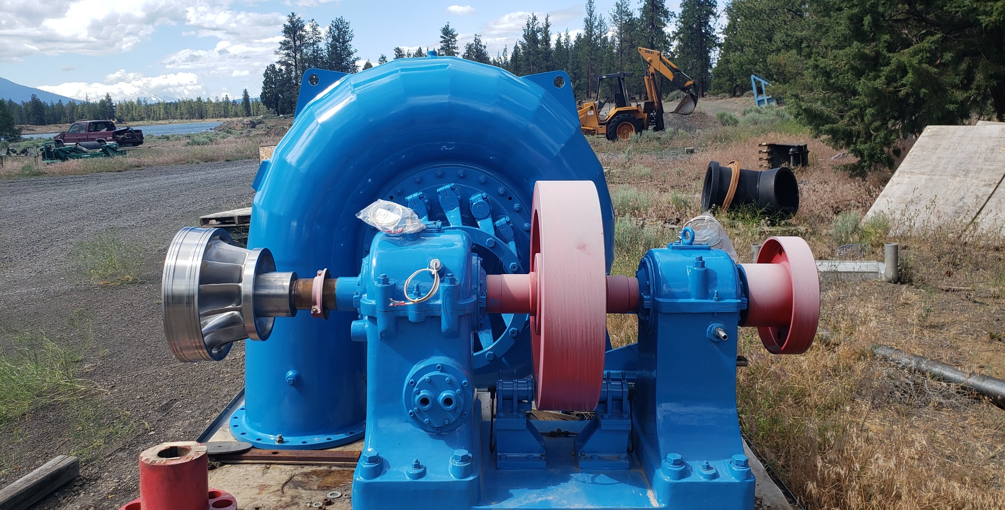
McKenzie 300 kW Runner/Shaft & Bearings Preassembled

Slide 34
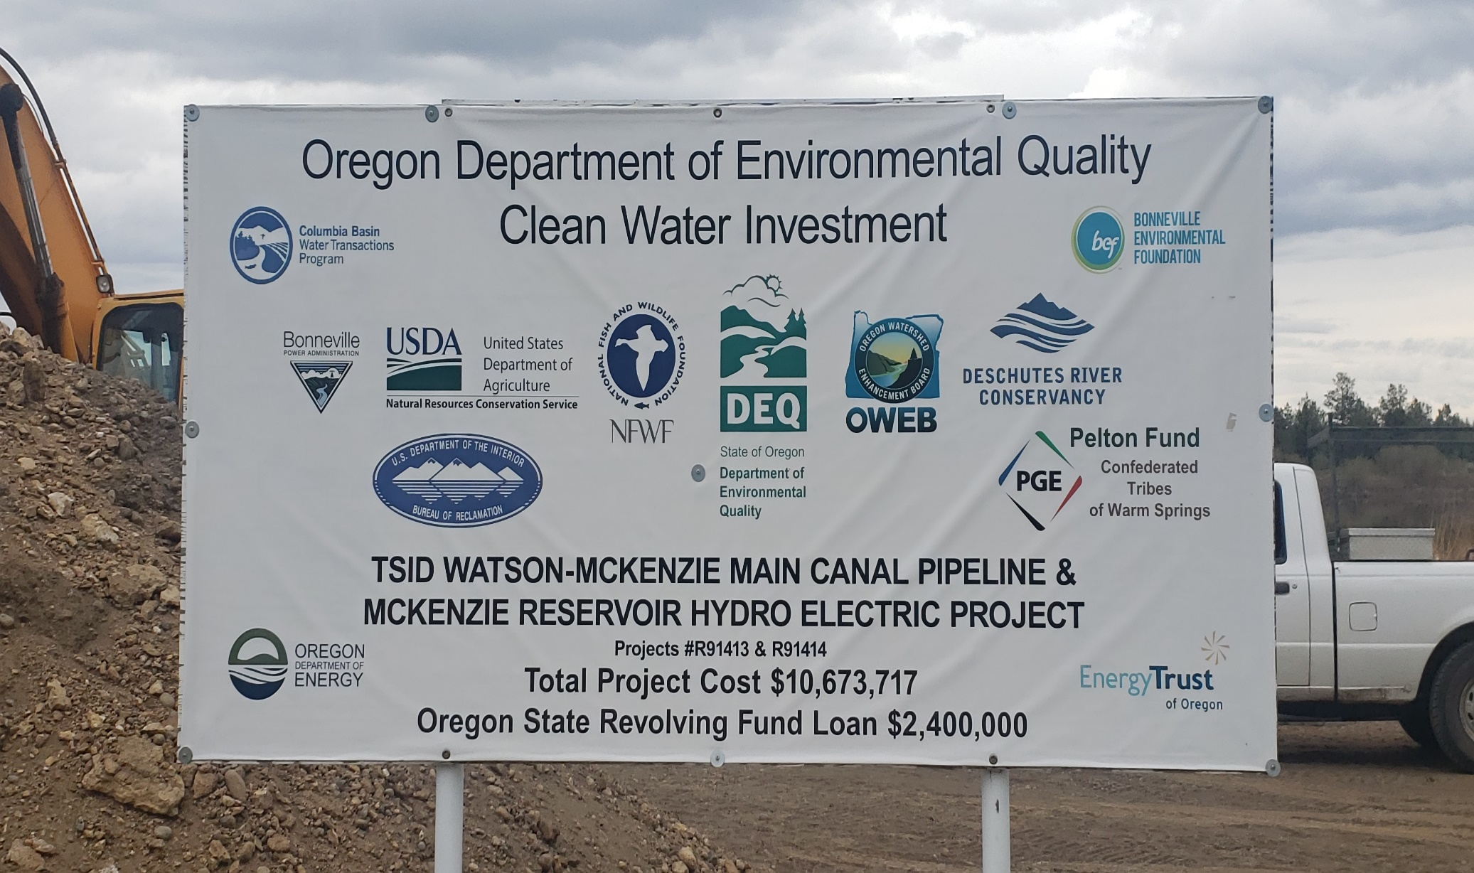
Design & Funding Partners

